Slide 1
CompTIA A+ Guide to IT Technical Support
10th Edition

Slide 2
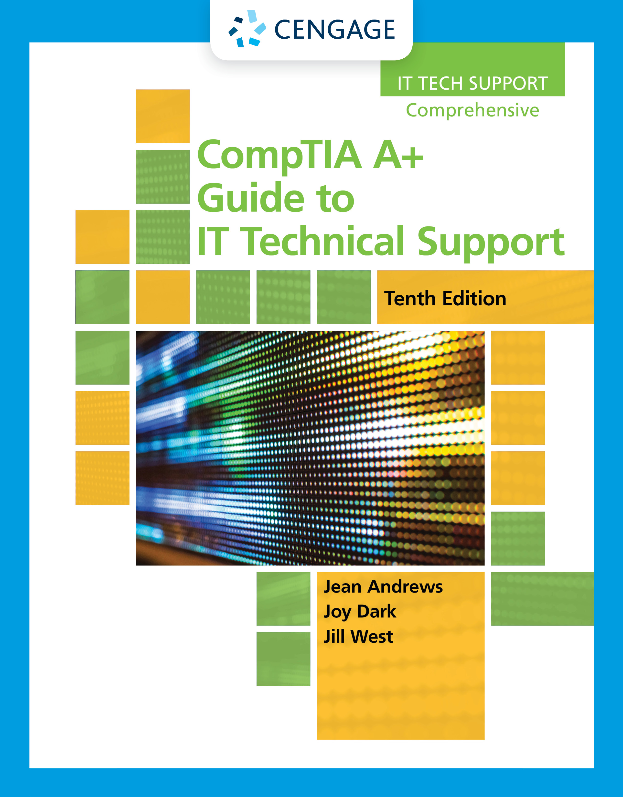
Taking a Computer Apart and Putting It Back Together

Slide 3
Objectives
Disassemble and reassemble a desktop computer safely while being able to identify various external ports and major components inside a desktop.
Disassemble and reassemble a laptop computer safely while being able to identify various external ports and slots and major components of a laptop.

Slide 4
Exploring a Desktop Computer
Every IT professional should know how to take a computer apart and put it back together again.
The following slides will cover this skill.

Slide 5
Step 1: Planning and Organizing Your Work and Gathering Your Tools (1 of 3)
Make notes for backtracking
Remove loose jewelry that might get caught
Stay organized by keeping small parts in one place
Do not stack boards on top of each other
Do not touch board chips
With hands or a magnetized screwdriver
Fingerprints on edge connectors may later cause corrosion
Never ever touch inside of a turned on computer
Consider monitor and power supply as “black boxes”
Never remove the cover or touch inside
Watch out for sharp edges that can cut

Slide 6
Step 1: Planning and Organizing Your Work and Gathering Your Tools (2 of 3)
Essential tools used by a computer hardware technician
ESD strap (ground bracelet)
Flat-head screwdriver
Phillips-head or cross-head screwdriver
Torx screwdriver set (size T15)
Insulated tweezers
OS recovery CD or DVD
Many other non-essential tools exist
Use a toolbox to house tools

Slide 7
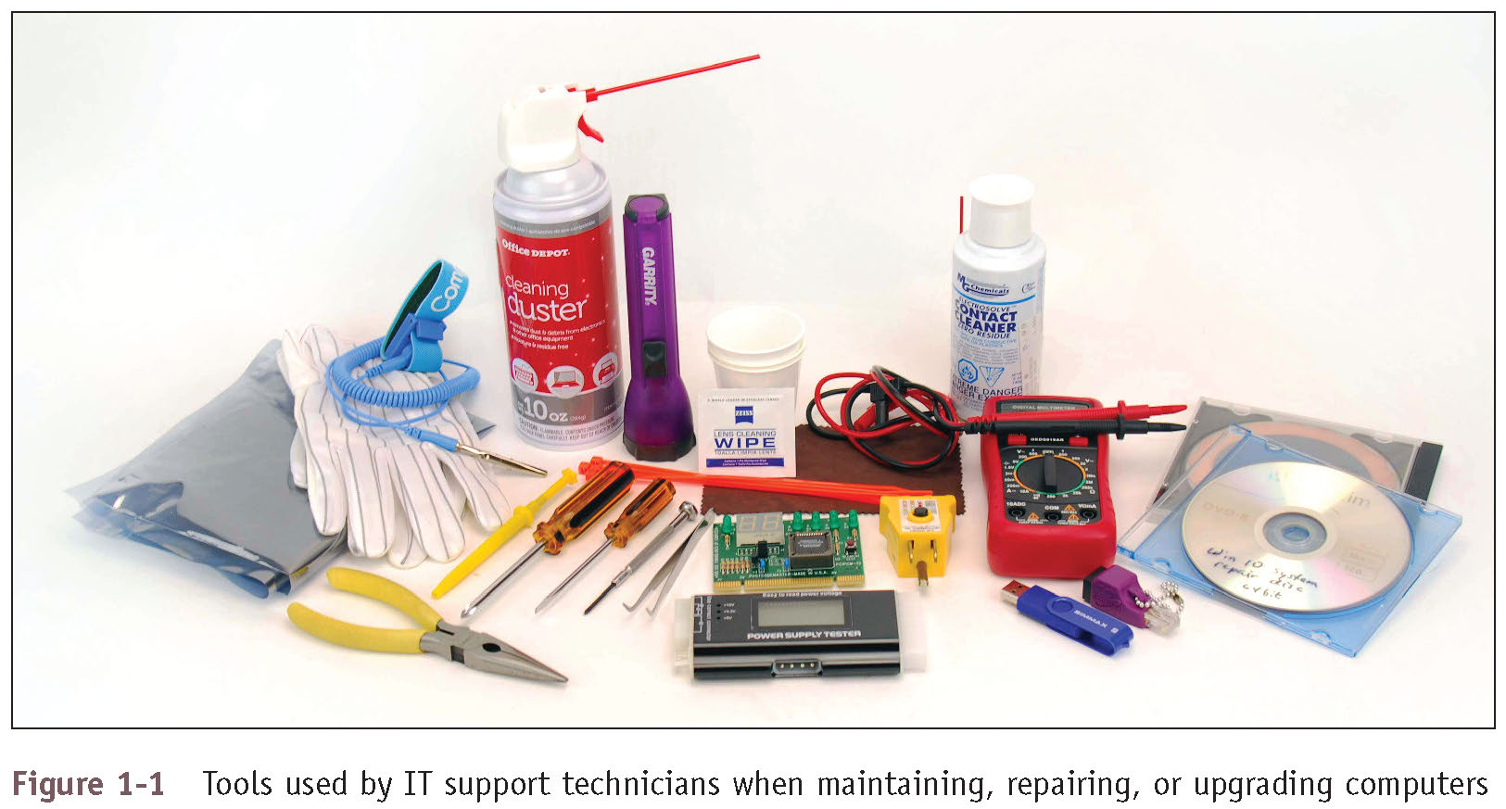
Step 1: Planning and Organizing Your Work and Gathering Your Tools (3 of 3)
Figure 1-1 Tools used by IT support technicians when maintaining, repairing, or upgrading computers

Slide 8
Step 2: Opening the Case (1 of 23)
A computer case for any type of computer is sometimes called the chassis
It houses the power supply, motherboard, processor, memory modules, expansion cards, hard drive, optical drive, and other drives
Can be a tower case, desktop case, all-in-one case, or a mobile case

Slide 9
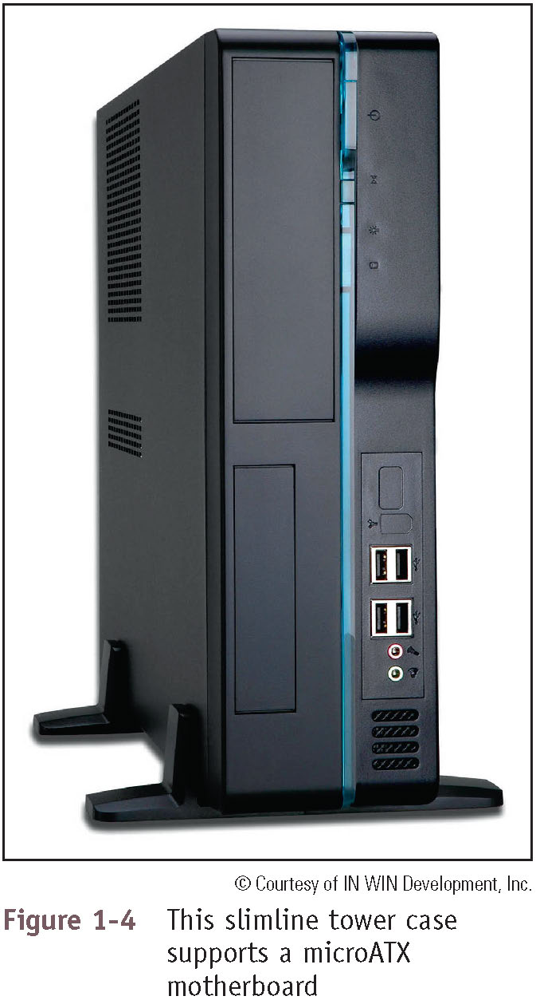
Step 2: Opening the Case (2 of 23)
Figure 1-4 This slimline tower case supports a microATX motherboard

Slide 10
Step 2: Opening the Case (3 of 23)
Loopback plugs:
Used to test a network port in a computer or other device to make sure the port is working
May also be used to test the throughput or speed of a port

Slide 11
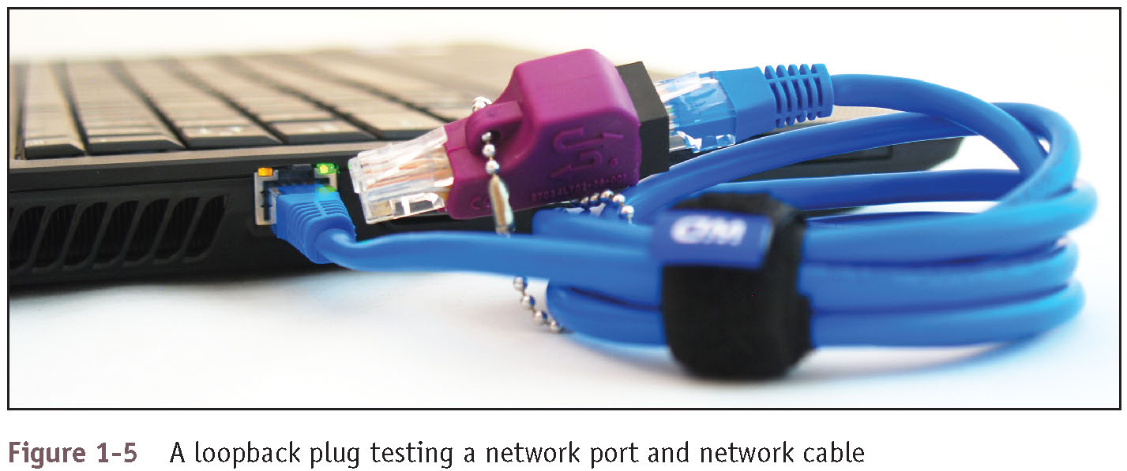
Step 2: Opening the Case (4 of 23)
Figure 1-5 A loopback plug testing a network port and network cable

Slide 12
Step 2: Opening the Case (5 of 23)
Back up important data
Power down the system and unplug it
Unplug other peripherals as well
Press and hold the power button for about 3 seconds
This will drain the power supply
Have a plastic bag or cup handy to hold screws
Open the case cover
Some cases require you to remove the faceplate first
Remove a side panel
Locate the screws or clips that hold the side panel in place and remove

Slide 13
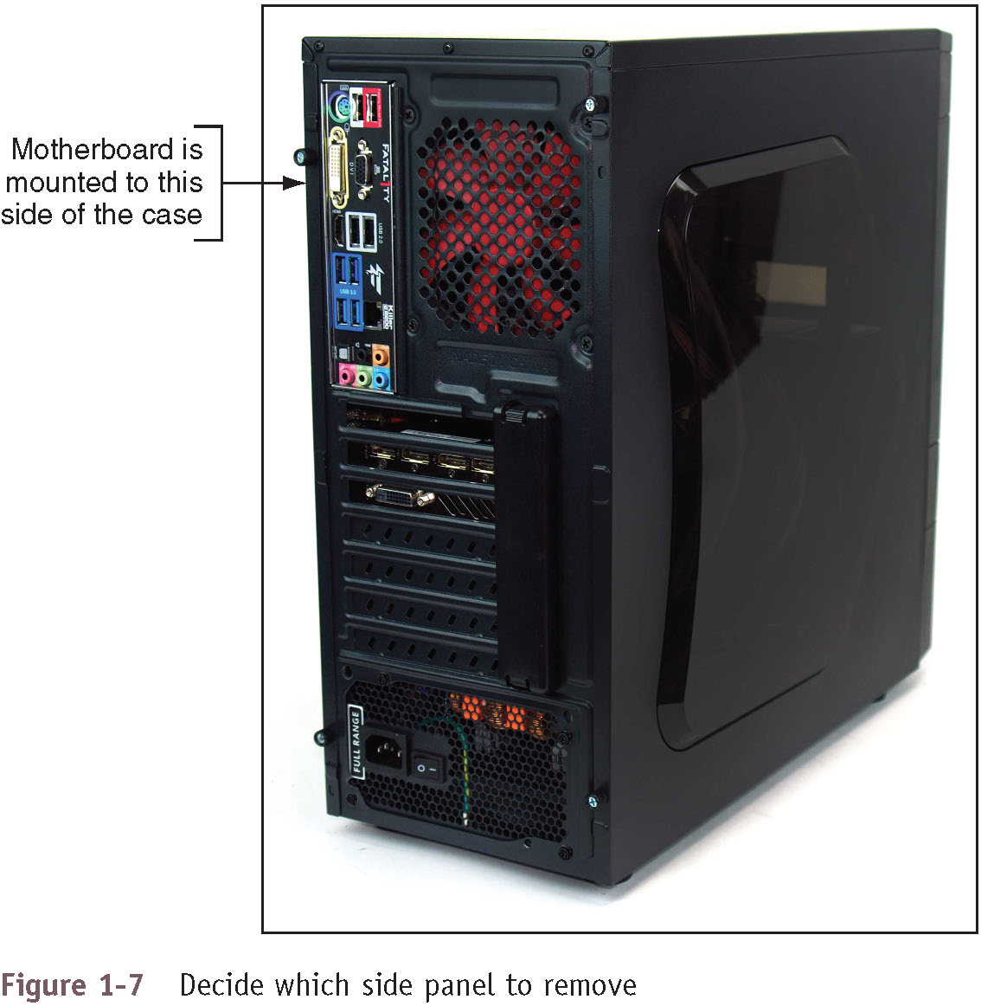
Step 2: Opening the Case (6 of 23)
Figure 1-7 Decide which side panel to remove

Slide 14
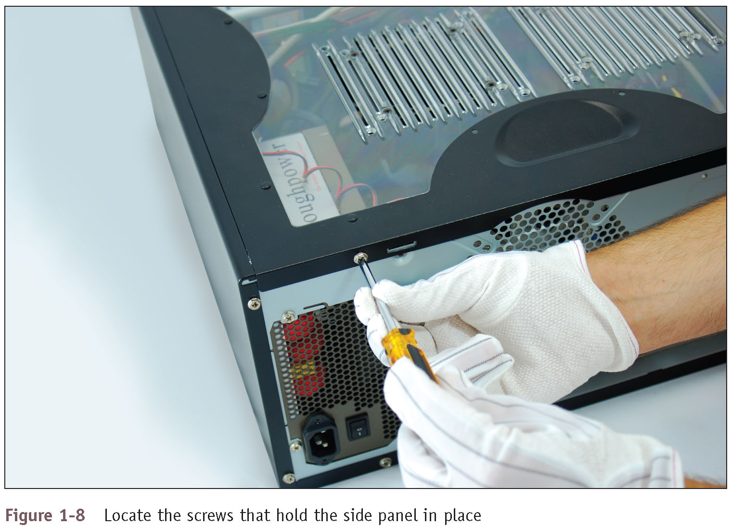
Step 2: Opening the Case (7 of 23)
Figure 1-8 Locate the screws that hold the side panel in place

Slide 15
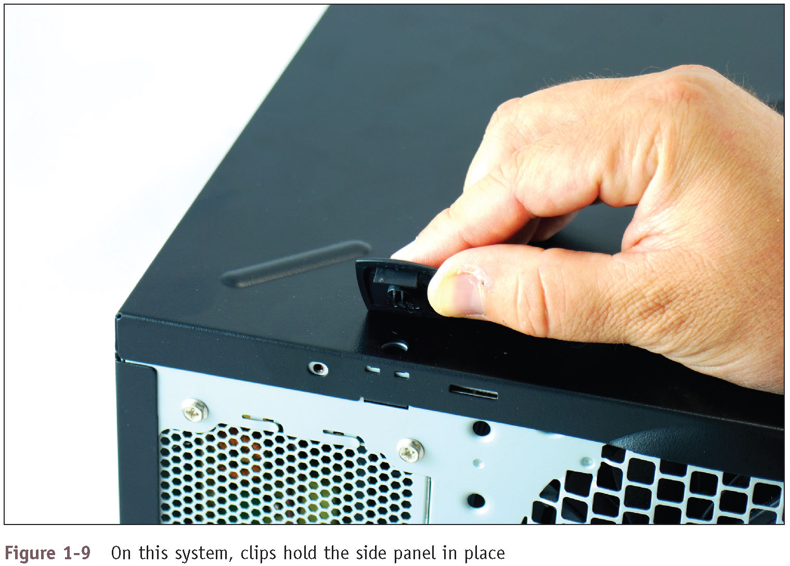
Step 2: Opening the Case (8 of 23)
Figure 1-9 On this system, clips hold the side panel in place

Slide 16
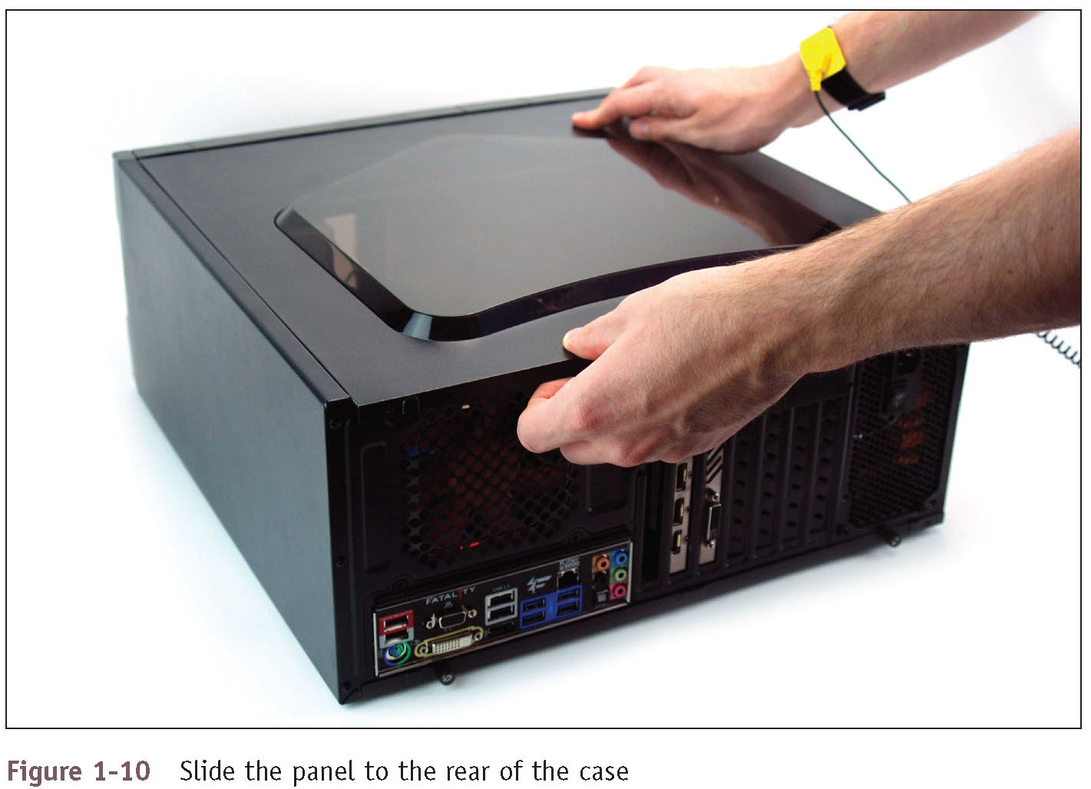
Step 2: Opening the Case (9 of 23)
Figure 1-10 Slide the panel to the rear of the case

Slide 17
Step 2: Opening the Case (10 of 23)
Clip your ESD strap to the side of the computer case
After opening you will see the main components:
Power supply
Motherboard
Drives
Follow cables from motherboard to the component to know the purpose of each cable

Slide 18
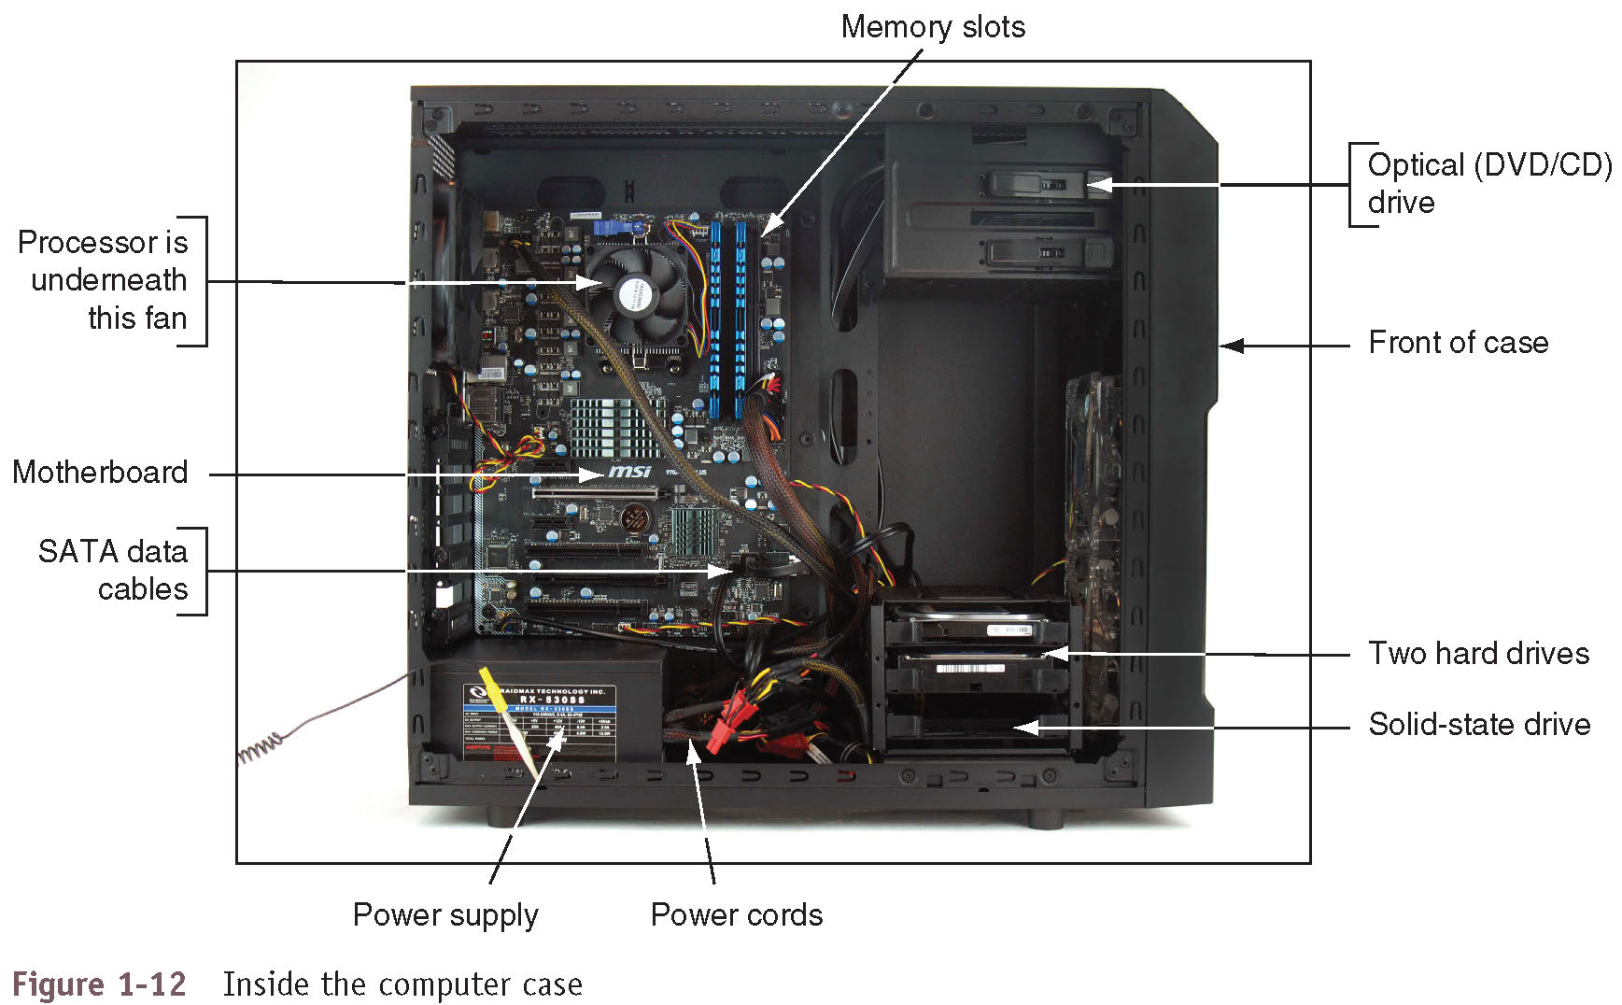
Step 2: Opening the Case (11 of 23)
Figure 1-12 Inside the computer case

Slide 19
Step 2: Opening the Case (12 of 23)
Main components installed in the case (called internal components):
Motherboard, processor, and cooler:
Motherboard is also called main board, system board, or mobo and contains a socket to hold the processor (CPU)
Processor processes data and instructions for the entire system
Generates a lot of heat so a fan and heat sink might be installed on top
The fan and heat sink together are called the processor cooler

Slide 20
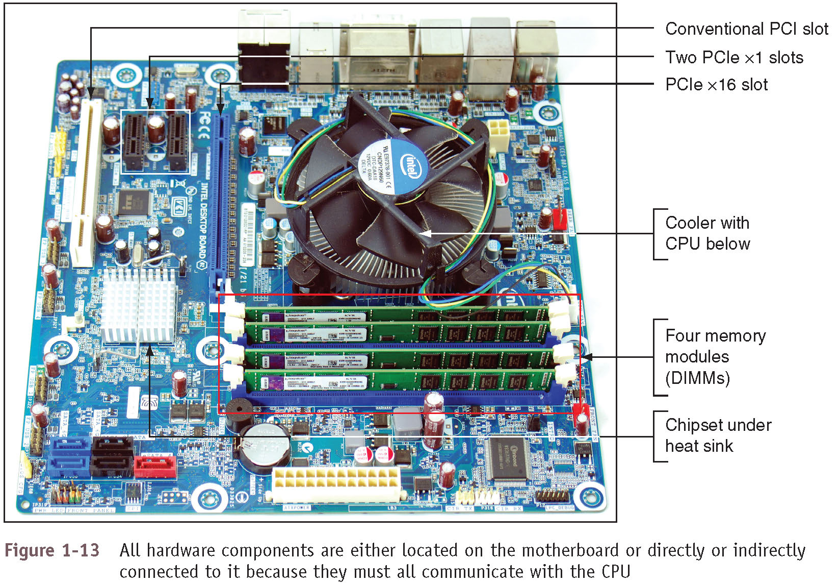
Step 2: Opening the Case (13 of 23)
Figure 1-13 All hardware components are either located on the motherboard or directly or indirectly connected to it because they must all communicate with the CPU

Slide 21
Step 2: Opening the Case (14 of 23)
Main components installed in the case (continued):
Expansion cards - also called adapter cards:
A circuit board that provides more ports than those provided by the motherboard
Today, most ports are provided by motherboards
Memory modules – random access memory (RAM):
Temporary storage for data and instructions as they are being processed by the CPU
Dual inline memory module (DIMM) slots hold memory modules

Slide 22
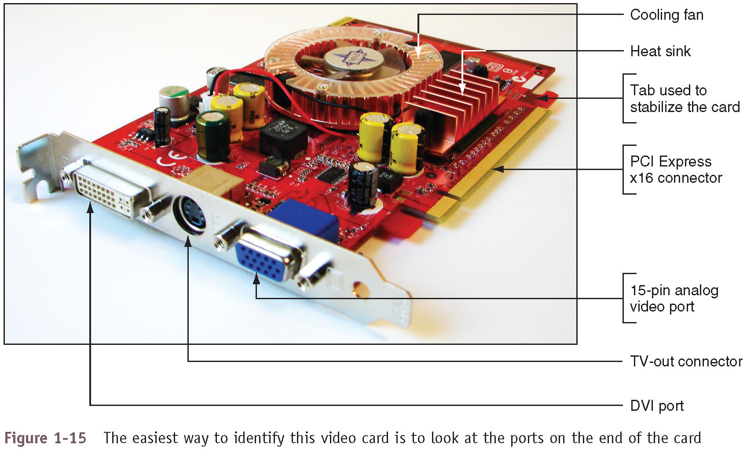
Step 2: Opening the Case (15 of 23)
Figure 1-15 The easiest way to identify this video card is to look at the ports on the end of the card

Slide 23
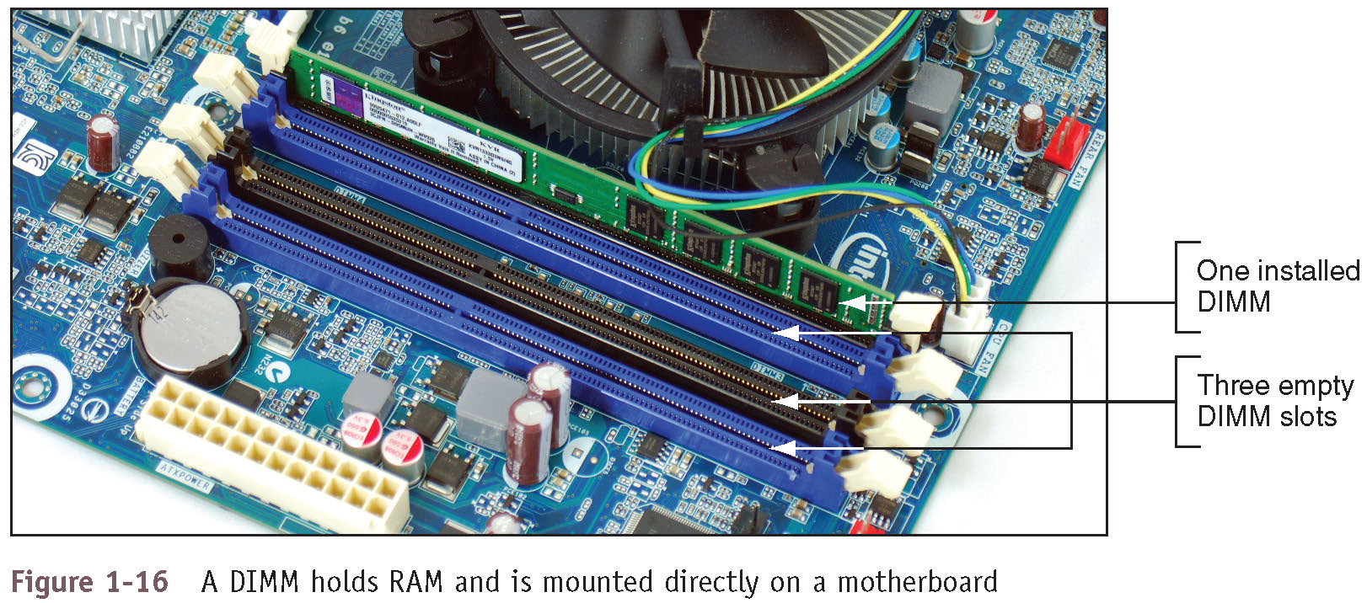
Step 2: Opening the Case (16 of 23)
Figure 1-16 A DIMM holds RAM and is mounted directly on a motherboard

Slide 24
Step 2: Opening the Case (17 of 23)
Main components installed in the case (continued):
Hard drives and other drives:
Hard drives may also be called hard disk drive (HDD)
Permanent storage used to hold data and programs
All drives in a system are installed in a stack of drive bays at the front of the case
Power supply – also called power supply unit (PSU):
Receives and converts house current so that components inside the case can use it
Most come with a dual-voltage selector switch
Allows switching input voltage from 115V to 220V

Slide 25
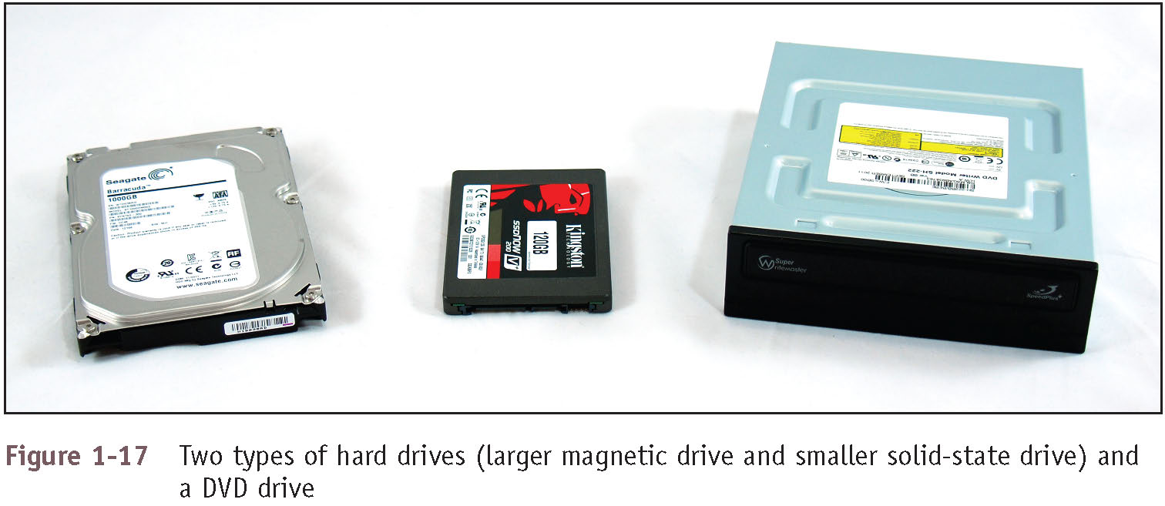
Step 2: Opening the Case (18 of 23)
Figure 1-17 Two types of hard drives (larger magnetic drive and smaller solid-state drive) and a DVD drive

Slide 26
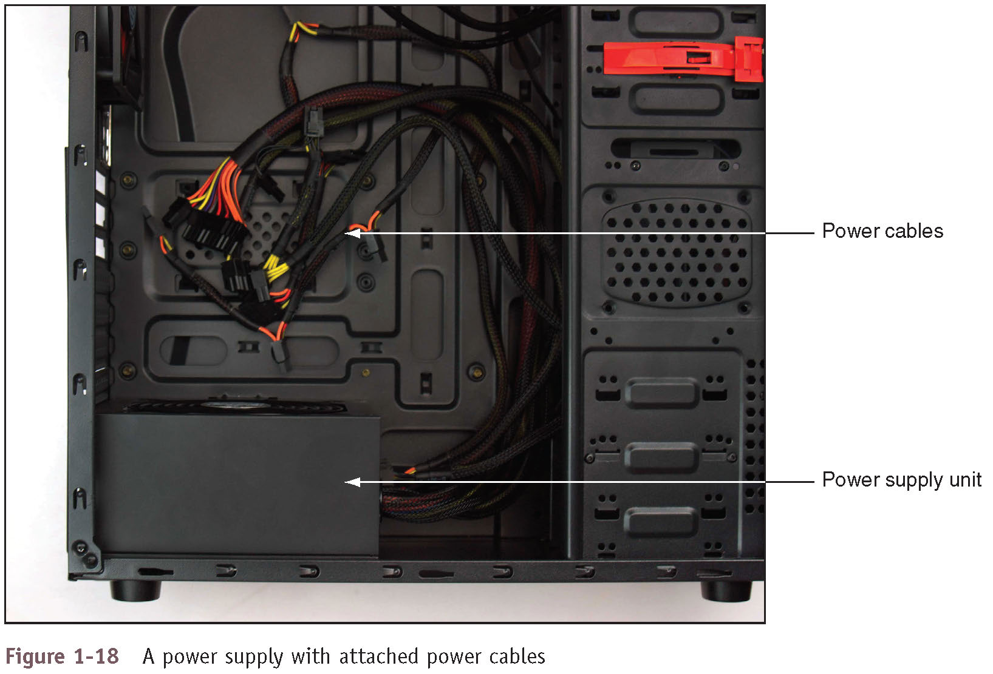
Step 2: Opening the Case (19 of 23)
Figure 1-18 A power supply with attached power cables

Slide 27
Step 2: Opening the Case (20 of 23)
Form factors:
Standards that describe the size, shape, screw hole positions, and major features of computer cases, power supplies, and motherboards
Necessary so that all will be compatible with each other
Two form factors used by most desktop and tower computer cases and power supplies:
ATX
microATX

Slide 28
Step 2: Opening the Case (21 of 23)
ATX (Advanced Technology Extended):
Most commonly used form factor today
Originally developed by Intel
It is an open, nonproprietary industry specification
An ATX power supply has a variety of power connectors
Power connectors have evolved because new technologies require more power
4-pin and 8-pin auxiliary connectors: used to provide an additional 12 V of power for evolving CPUs
24-pin or 20+4-pin P1 connector
The older 20-pin P1 connector still worked in this connector
Supported the new PCI Express (PCIe) slots
6-pin and 8-pin PCIe connectors connect directly to the video card
Video cards draw the most power in a system

Slide 29
Step 2: Opening the Case (22 of 23)
microATX (mATX) form factor:
Major variation of ATX
Reduces total cost of a system by:
Reducing number of expansion slots on motherboard
Reducing power supplied to the board
Allowing for a smaller case size
Uses a 24-pin P1 connector
Not likely to have as many extra wires and connectors as those on the ATX power supply

Slide 30
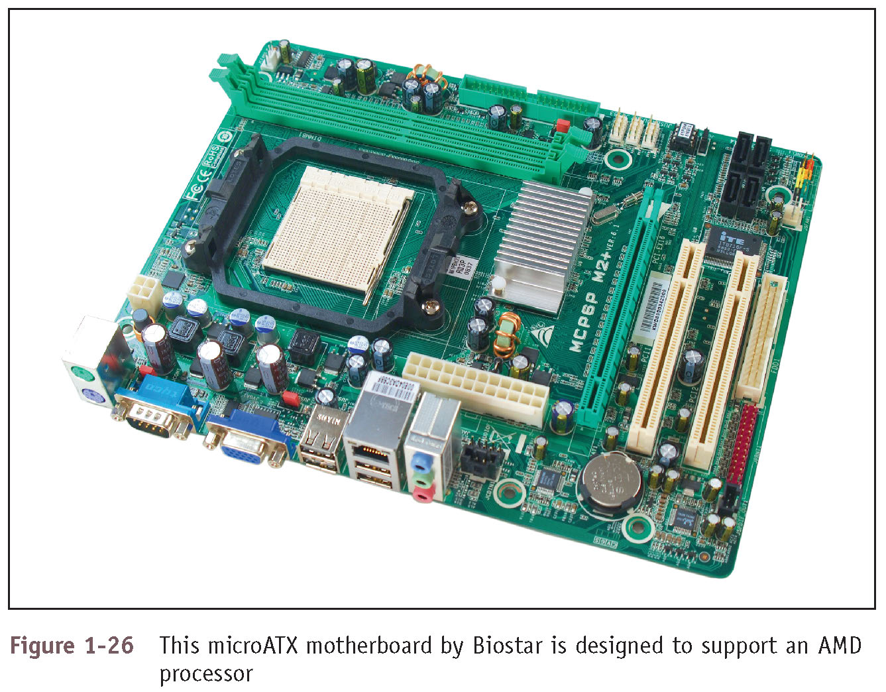
Step 2: Opening the Case (23 of 23)
Figure 1-26 This microATX motherboard by Biostar is designed to support an AMD processor

Slide 31
Step 3: Removing Expansion Cards (1 of 2)
If removing components:
Draw a diagram of all cable connections to the motherboard, expansion cards, and drives
Use a felt-tip marker to mark components in order to indicate a cable connection, board placement, orientation, etc.
To remove expansion cards:
Remove any wire or cable connected to the card
Remove the screw holding the card to the case
Grasp the card with both hands and remove it by lifting straight up (can also very slightly rock the card from end to end)
Don’t put your fingers on edge connectors or touch a chip
It is best to store cards in an antistatic bag

Slide 32
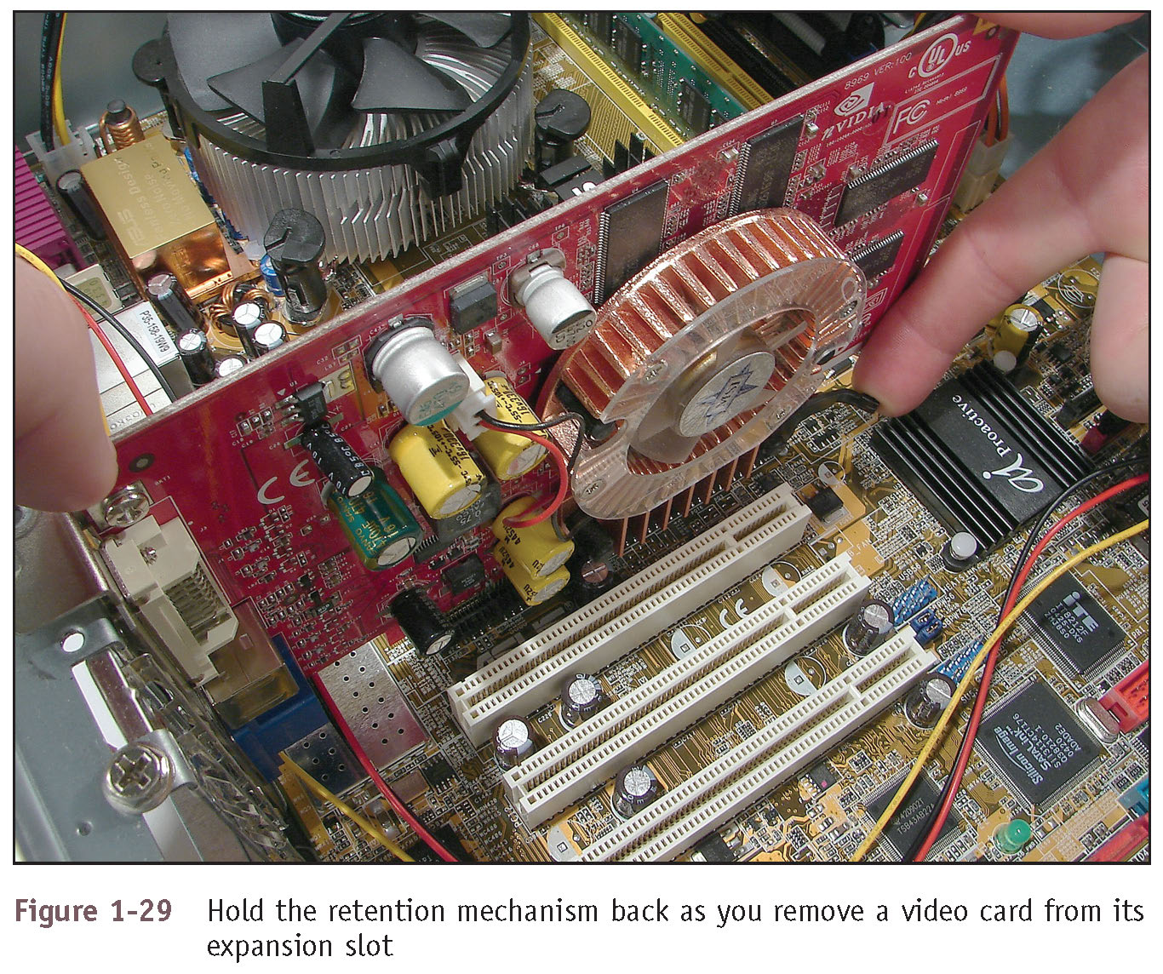
Step 3: Removing Expansion Cards (2 of 2)
Figure 1-29 Hold the retention mechanism back as you remove a video card from its expansion slot

Slide 33
Step 4: Removing the Motherboard (1 of 3)
Depending on the system, you may have to remove the drives and/or power supply to get to the motherboard
To remove motherboard:
Unplug power supply lines
Unplug SATA cables connected to the motherboard
Disconnect wires leading from the front of the computer case to the motherboard (called front panel connectors)
Make a diagram before disconnecting
Disconnect any other cables or wires connected to the motherboard
Remove the screws that hold the motherboard to the case
Spacers (standoffs) – round plastic or metal pegs that separate the board from the case
Motherboard should be free to remove from the case

Slide 34
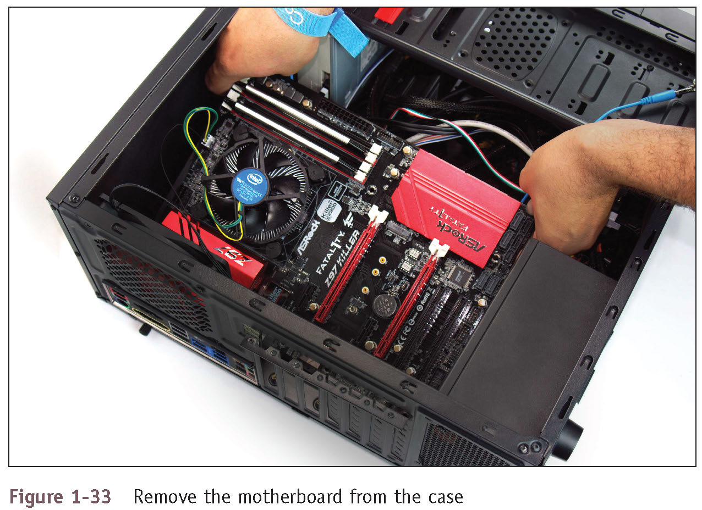
Step 4: Removing the Motherboard (2 of 3)
Figure 1-33 Remove the motherboard from the case

Slide 35
Step 4: Removing the Motherboard (3 of 3)
Post Diagnostic Cards:
Helps discover, report computer errors and conflicts at power-on self test (POST)
Firmware – programs and data stored on the motherboard
Consists of older BIOS firmware and the newer UEFI firmware
Usually referred to as BIOS/UEFI
POST is a series of tests performed by the startup BIOS/UEFI
If you have a problem that prevents the computer from booting and you suspect it is related to hardware:
Install the POST card in an expansion slot on the motherboard
The card monitors the boot process and reports errors

Slide 36
Step 5: Removing the Power Supply (1 of 4)
To remove the power supply from the case:
Look for screws that attach the power supply to the computer case
Do not remove screws that hold power supply housing together (do not take housing apart)
Sometimes power supplies are also attached to the case on the underside by recessed slots:
Turn case over and look for slots
If present, determine in which direction you need to slide the power supply to free it from the case

Slide 37
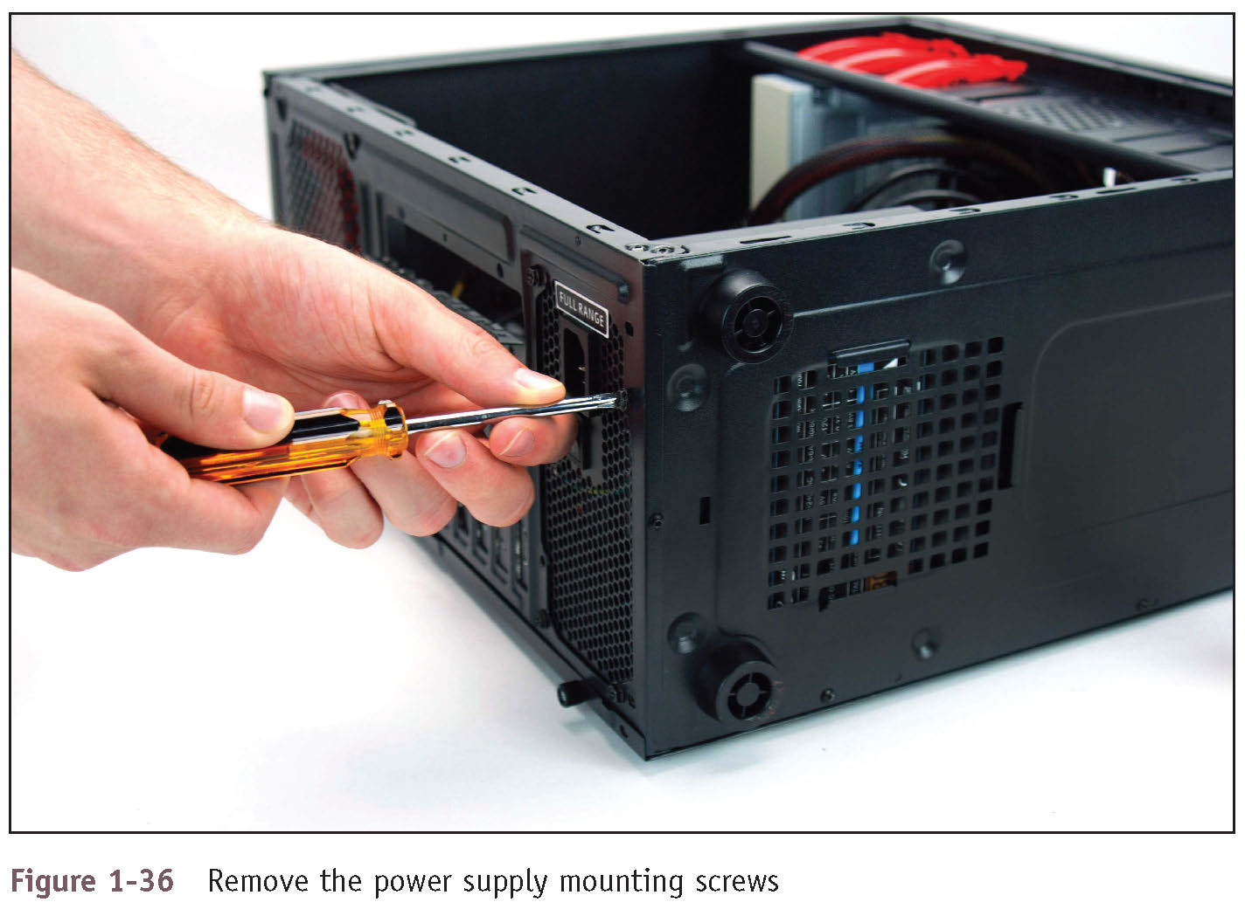
Step 5: Removing the Power Supply (2 of 4)
Figure 1-36 Remove the power supply mounting screws

Slide 38
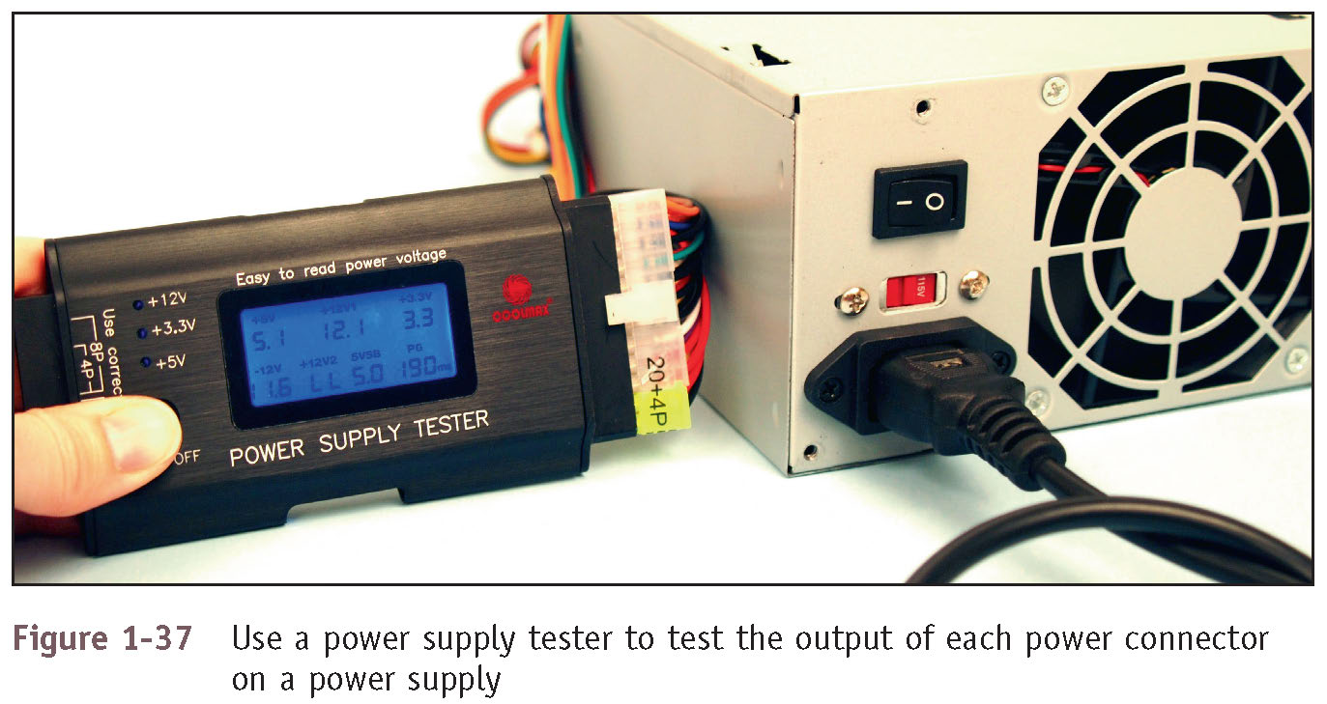
Step 5: Removing the Power Supply (3 of 4)
Figure 1-37 Use a power supply tester to test the output of each power connector on a power supply

Slide 39
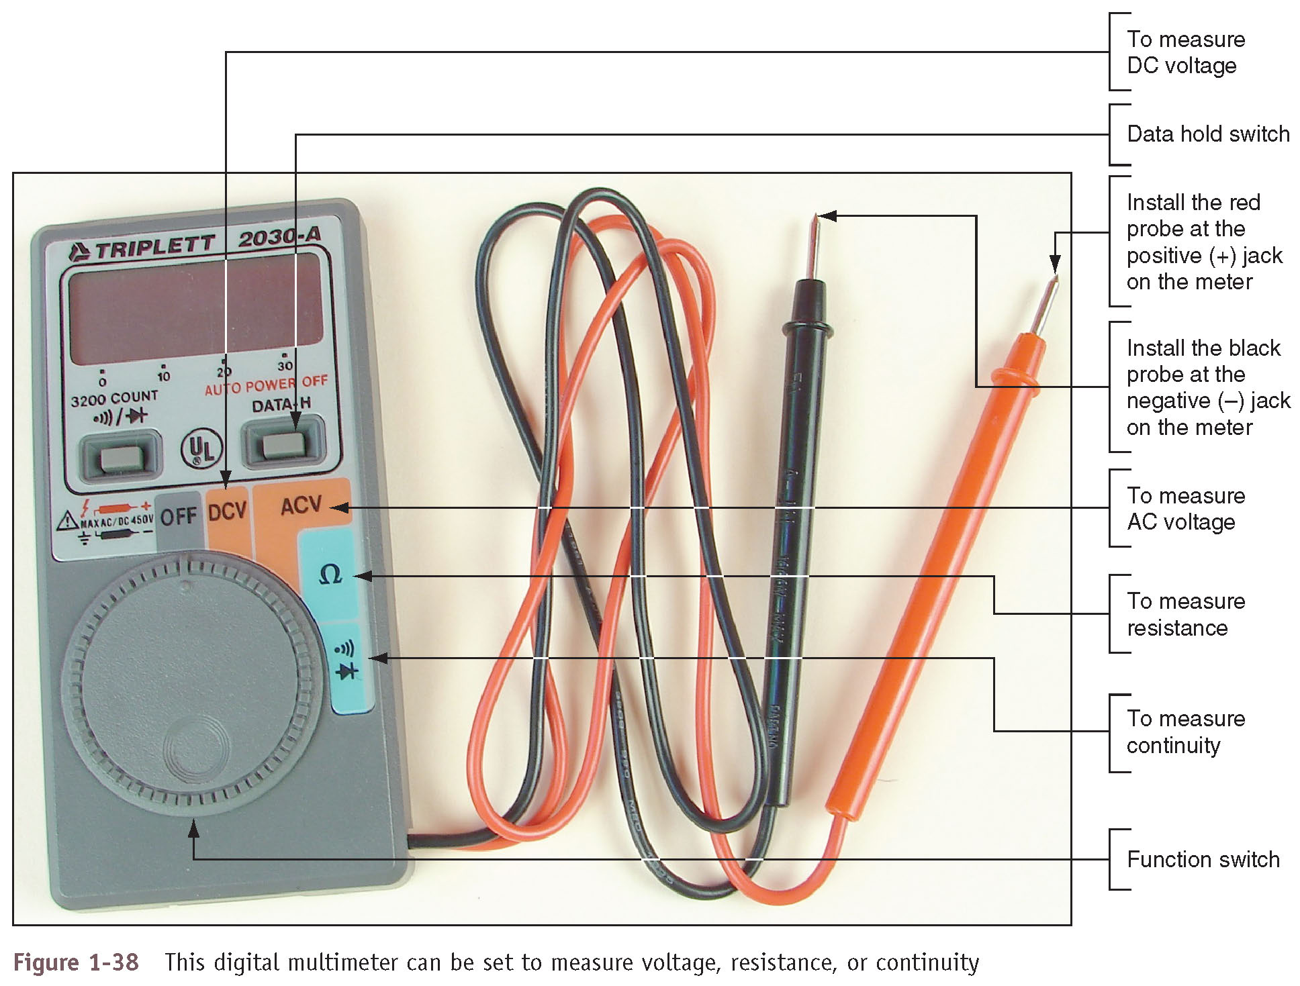
Step 5: Removing the Power Supply (4 of 4)
Figure 1-38 This digital multimeter can be set to measure voltage, resistance, or continuity

Slide 40
Step 6: Removing the Drives (1 of 5)
A drive receives power by a power cable from the power supply and communicates instructions and data through a cable attached to the motherboard
Most hard drives and optical drives today use the serial ATA (SATA) standard
Tips to remove drives:
Look for screws on each side of the drive attaching the drive to the drive bay
There might be a catch underneath the drive
You must lift up as you slide the drive forward
Some drive bays have a clipping mechanism to hold the drive in the bay
Release the clip and then pull the drive forward
Some drives must be removed through the front of the case
May need to remove the front panel of the case to remove the drive
Some cases have a removable bay for smaller hard drives

Slide 41
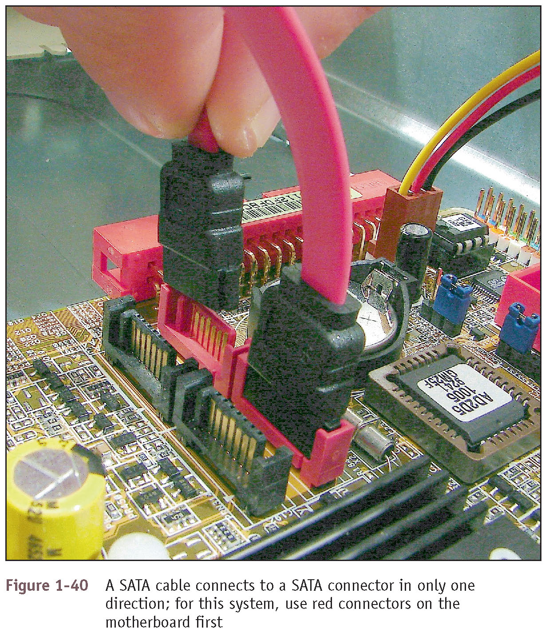
Step 6: Removing the Drives (2 of 5)
Figure 1-40 A SATA cable connects to a SATA connector in only one direction; for this system, use red connectors on the motherboard first

Slide 42
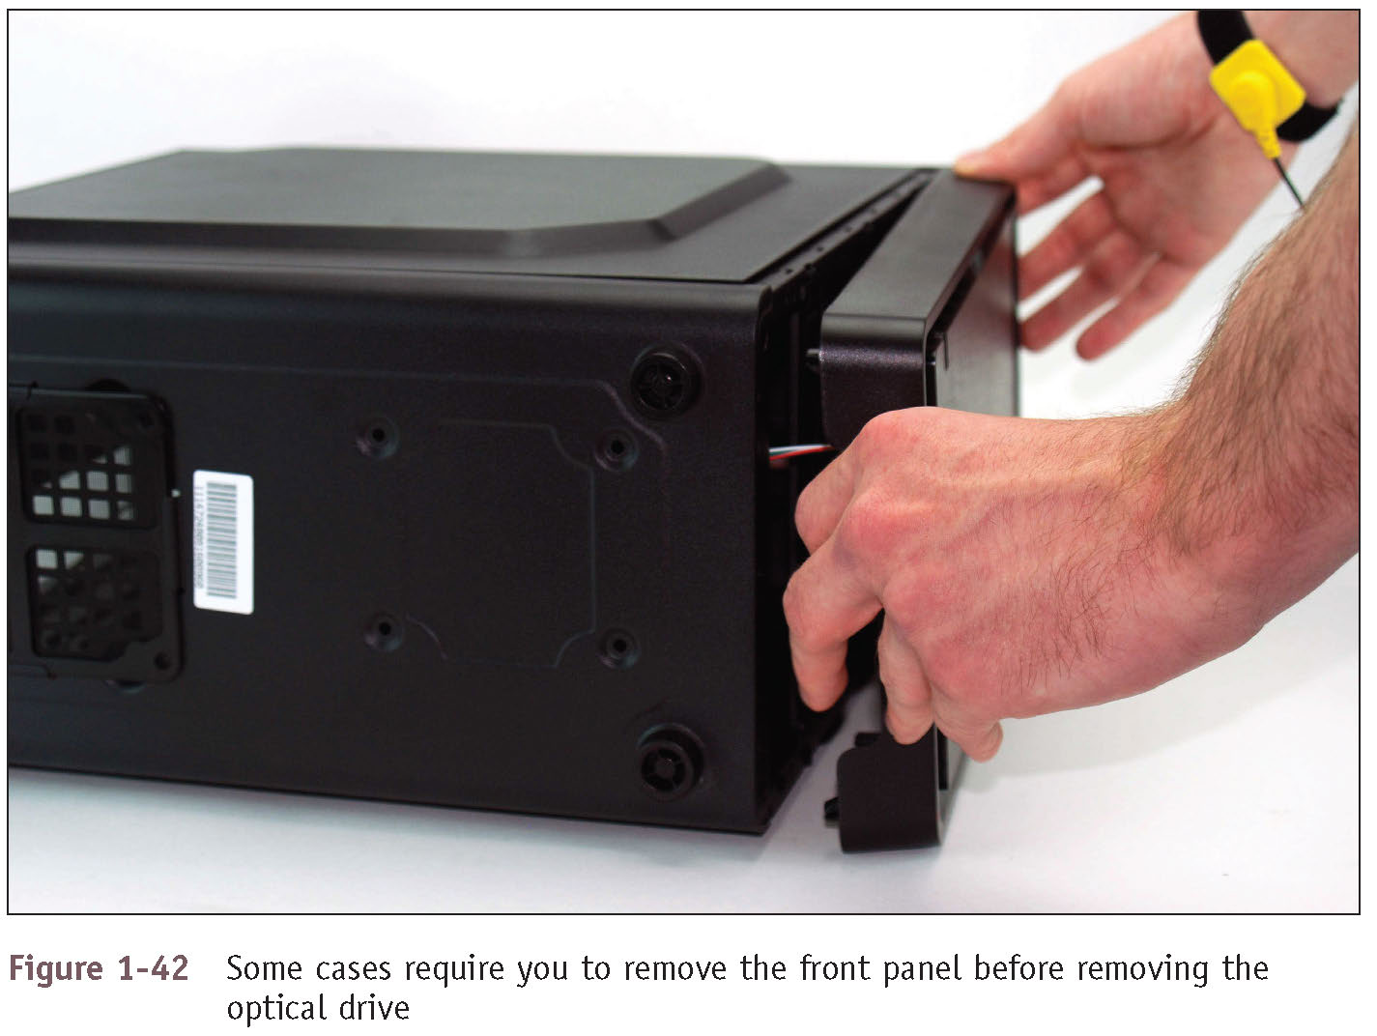
Step 6: Removing the Drives (3 of 5)
Figure 1-42 Some cases require you to remove the front panel before removing the optical drive

Slide 43
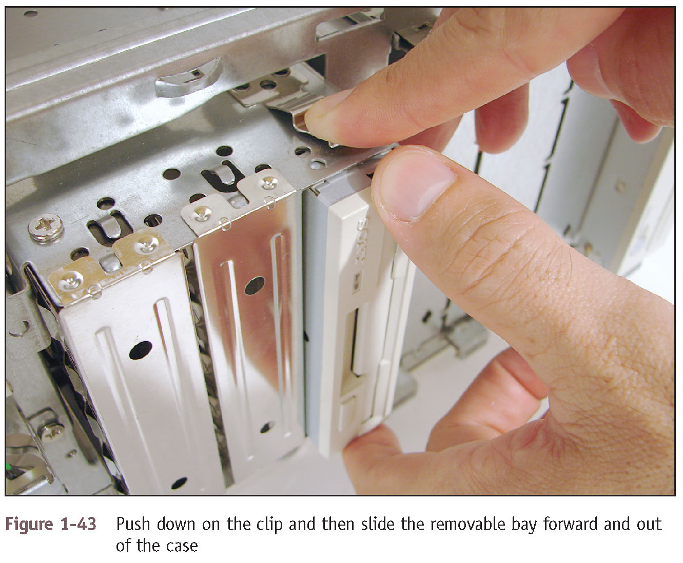
Step 6: Removing the Drives (4 of 5)
Figure 1-43 Push down on the clip and then slide the removable bay forward and out of the case

Slide 44
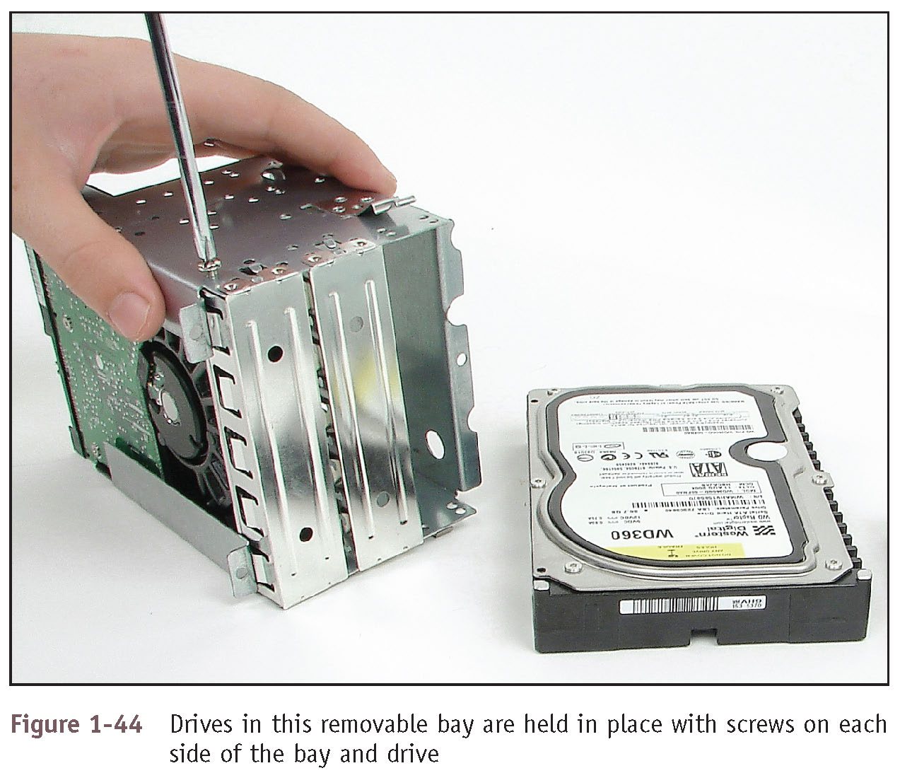
Step 6: Removing the Drives (5 of 5)
Figure 1-44 Drives in this removable bay are held in place with screws on each side of the bay and drive

Slide 45
Steps to Put a Computer Back Together (1 of 7)
Refer to any diagrams created during the disassembling process
1. Install components in this order: power supply, drives, motherboard, and cards
When installing drives, it may be easier to connect cables to the drives before sliding them into the bay
2. Place motherboard inside the case
Make sure ports and screw holes are lined up
3. Connect the power cords from the power supply to the motherboard
Will always need the main P1 power connector and may likely need the 4-pin auxiliary connector for the processor

Slide 46
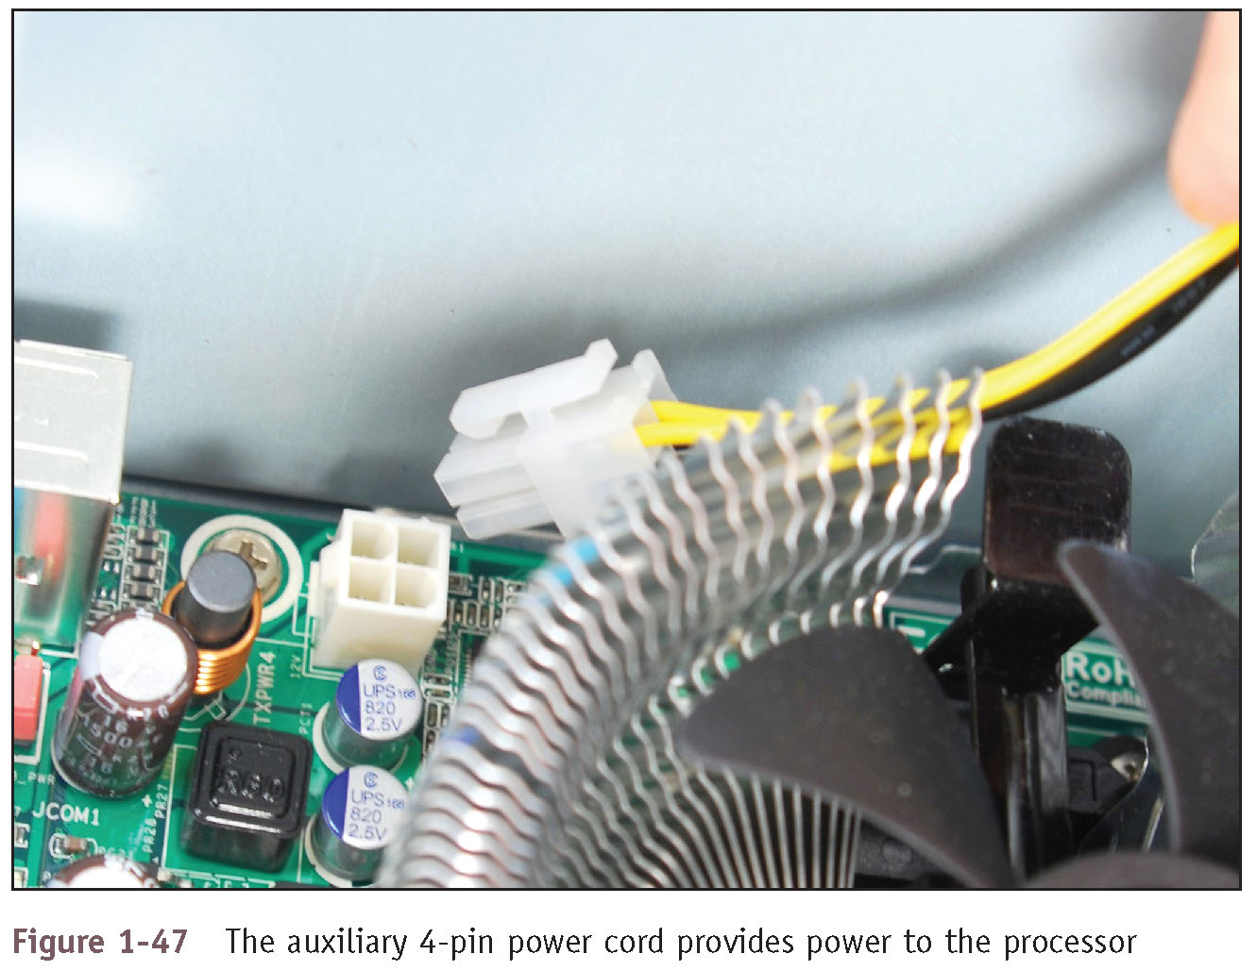
Steps to Put a Computer Back Together (2 of 7)
Figure 1-47 The auxiliary 4-pin power cord provides power to the processor

Slide 47
Steps to Put a Computer Back Together (3 of 7)
4. Connect wire leads from the front panel of the case to the front panel header on motherboard
To help orient the larger connectors, look for a small triangle embedded on the connector that marks one of the outside wires as pin 1
Line up pin 1 on connector with pin 1 marked on motherboard
If labels on motherboard are not clear, consult user guide for help
5. Connect wires to ports on the front panel of the case
Audio ports or USB ports are examples

Slide 48
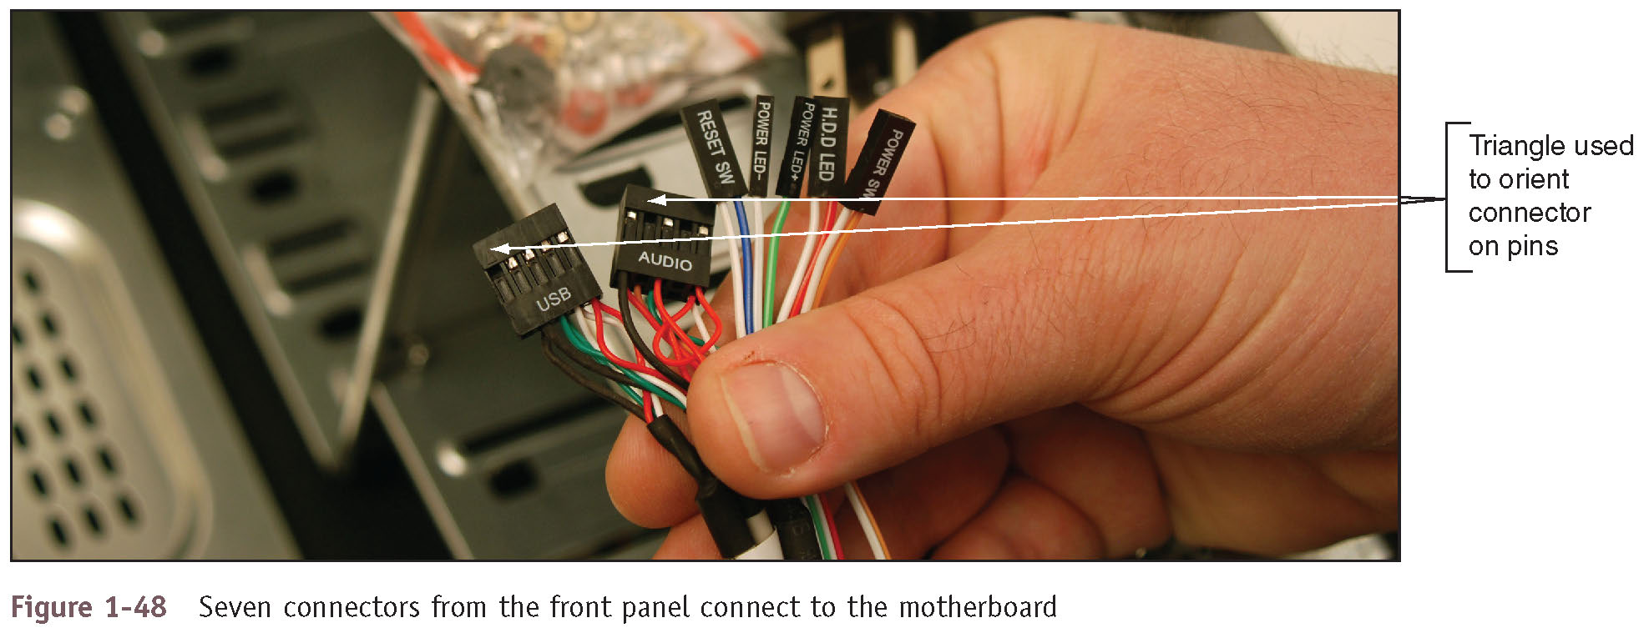
Steps to Put a Computer Back Together (4 of 7)
Figure 1-48 Seven connectors from the front panel connect to the motherboard

Slide 49
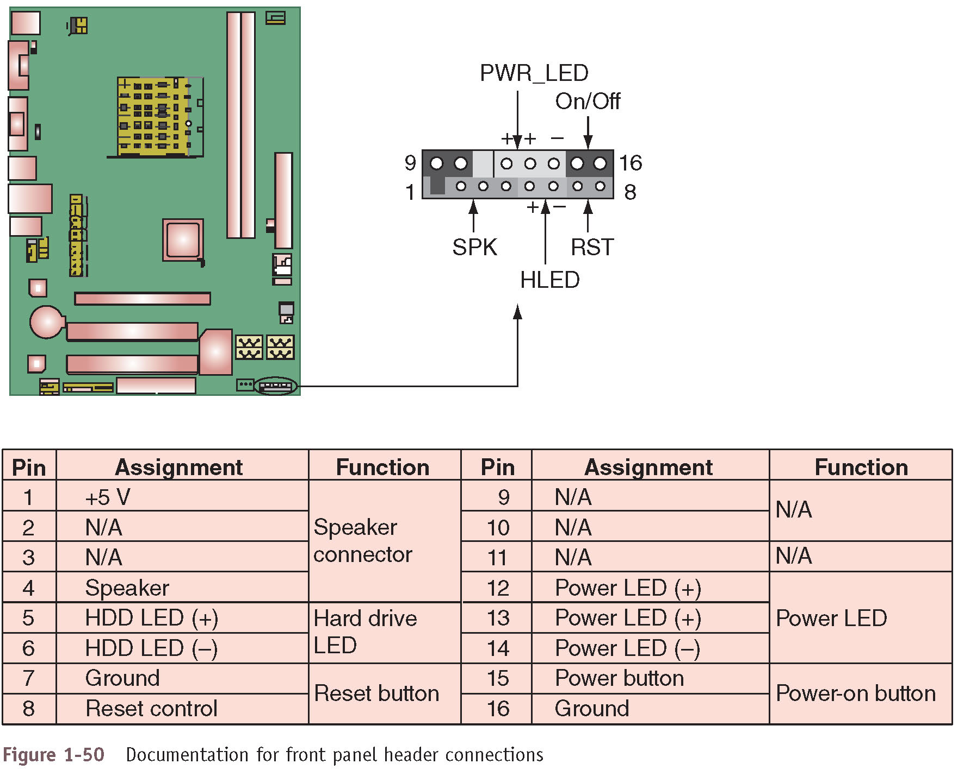
Steps to Put a Computer Back Together (5 of 7)
Figure 1-50 Documentation for front panel header connections

Slide 50
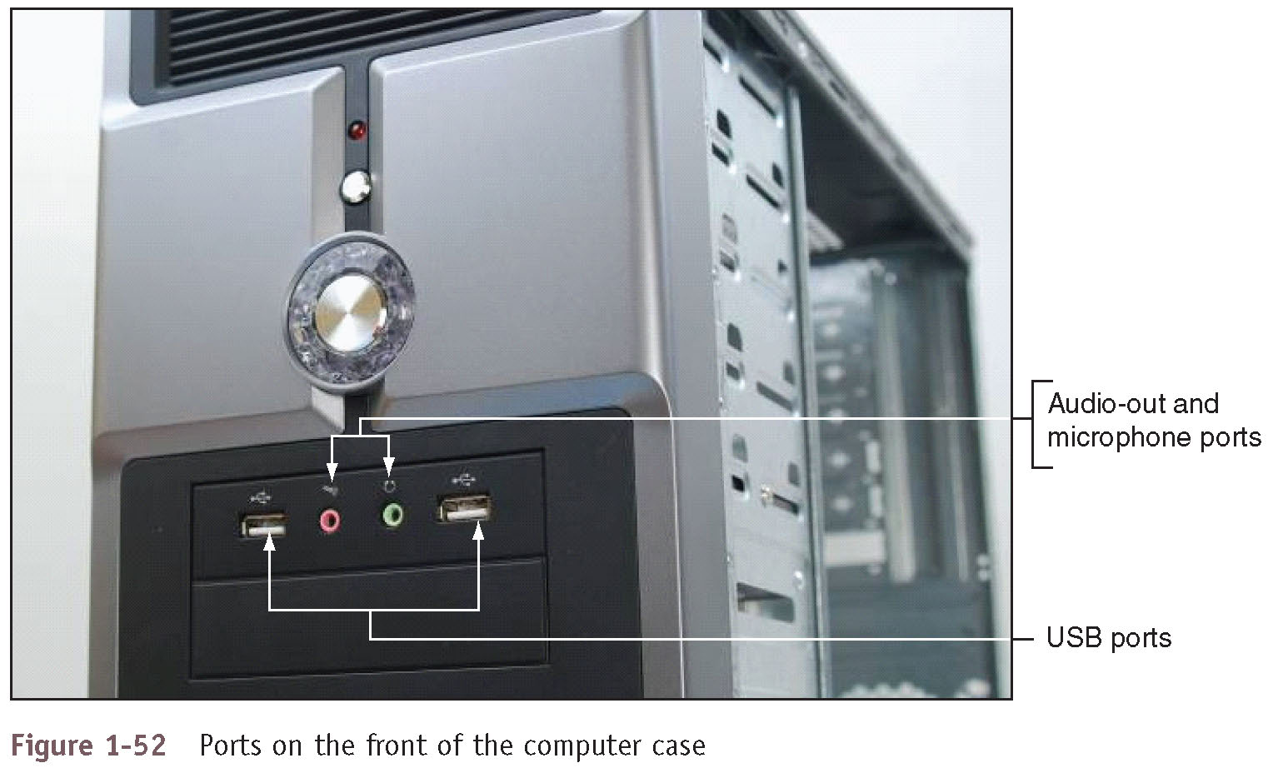
Steps to Put a Computer Back Together (6 of 7)
Figure 1-52 Ports on the front of the computer case

Slide 51
Steps to Put a Computer Back Together (7 of 7)
6. Install the video card and other expansion cards
7. Double-check each connection
8. Plug in keyboard, monitor, and mouse
9. In classroom environment, have instructor check work
10. Turn on the power and check that the PC is working properly
If not, it is most likely a loose connection

Slide 52
First Look at Laptop Computers (1 of 6)
Laptop (notebook) is designed for portability and can be just as powerful as a desktop
Uses the same technology as desktops, but with modifications to use less power, take up less space, and operate on the move
Varieties of laptops include:
Those with a touch screen that allows you to handwrite on it with a stylus
Some are outfitted with a rotating or removable screen that allows you to use the laptop as a tablet
Netbook – a smaller and less expensive version with fewer features
All-in-one computer – the monitor and computer case are built together and uses components common to both a laptop and a desktop

Slide 53
First Look at Laptop Computers (2 of 6)
Ports common to laptops include:
USB, network, and audio ports
Video ports might include one or more VGA, DisplayPort, Thunderbolt, or HDMI ports
Most laptops include a lock connector that’s used to physically secure the laptop with a cable lock
Most laptops include slots for flash memory cards
When a laptop is missing a port or slot, you can use a USB dongle to provide the port or slot
Examples:
USB to RJ-45 dongle to connect to a wired network
USB to Wi-Fi dongle to connect to a wireless network

Slide 54
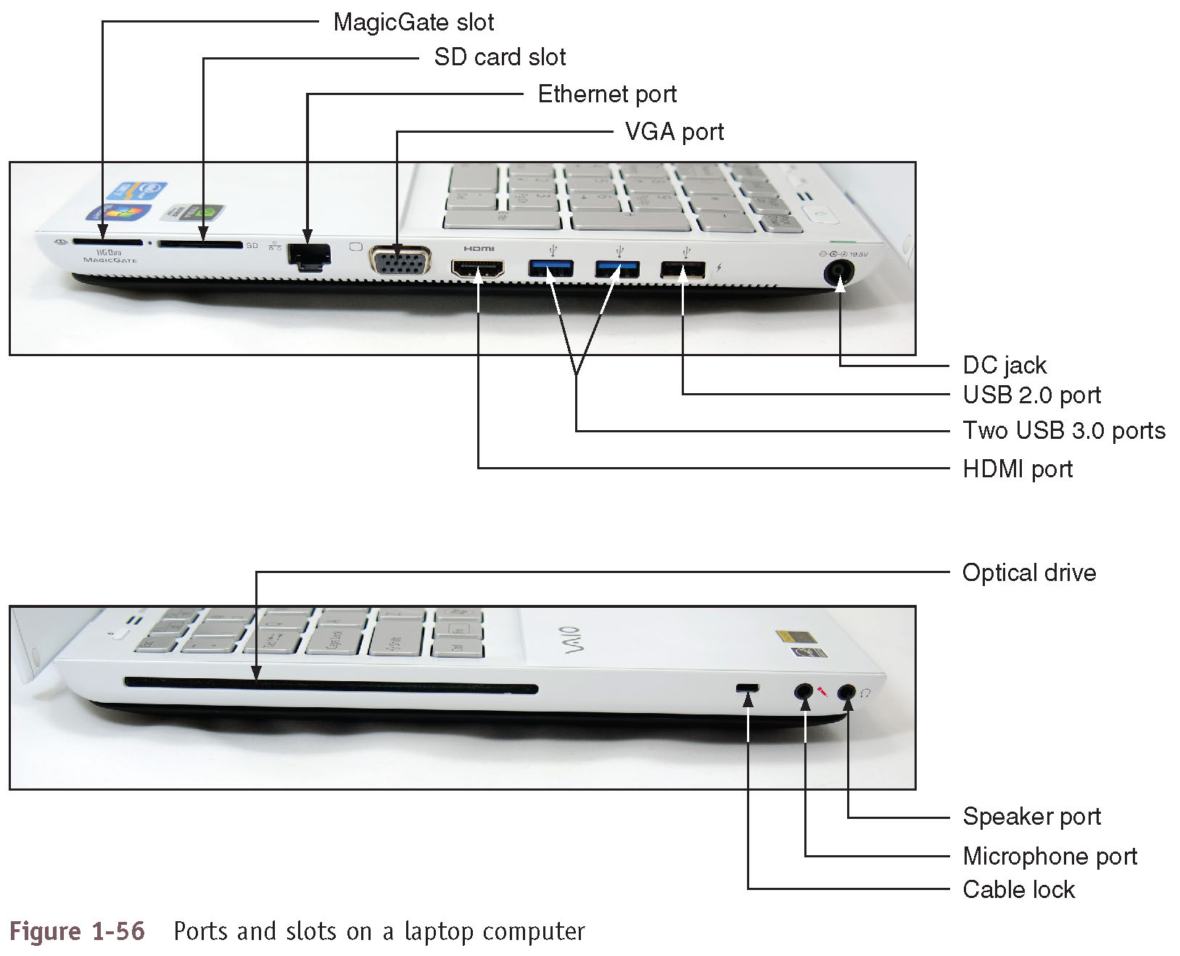
First Look at Laptop Computers (3 of 6)
Figure 1-56 Ports and slots on a laptop computer

Slide 55
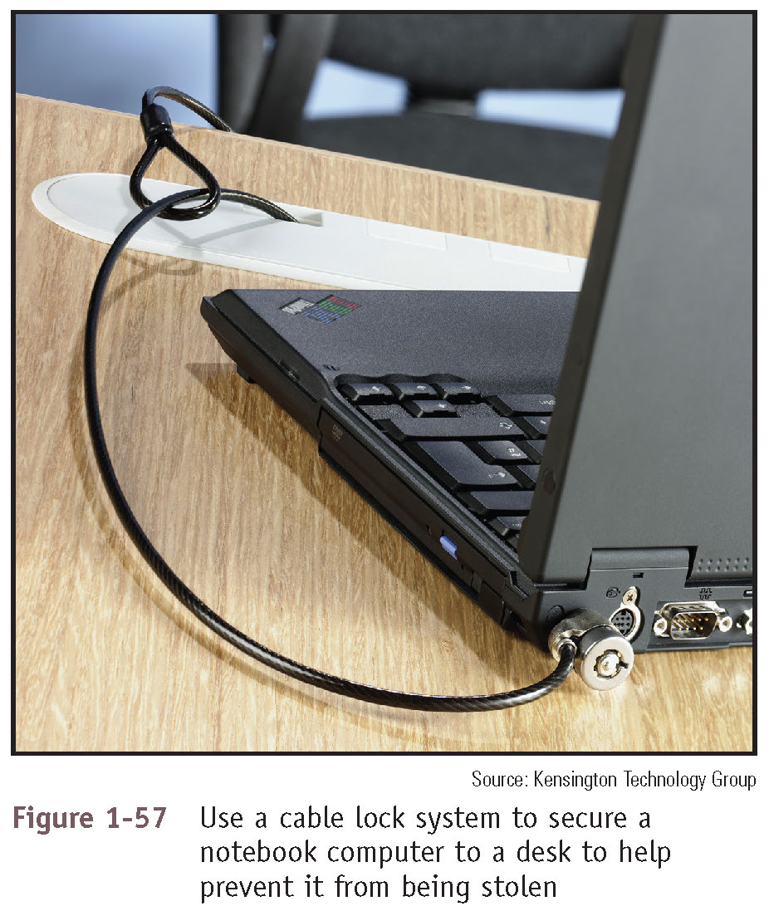
First Look at Laptop Computers (4 of 6)
Figure 1-57 Use a cable lock system to secure a notebook computer to a desk to help prevent it from being stolen

Slide 56
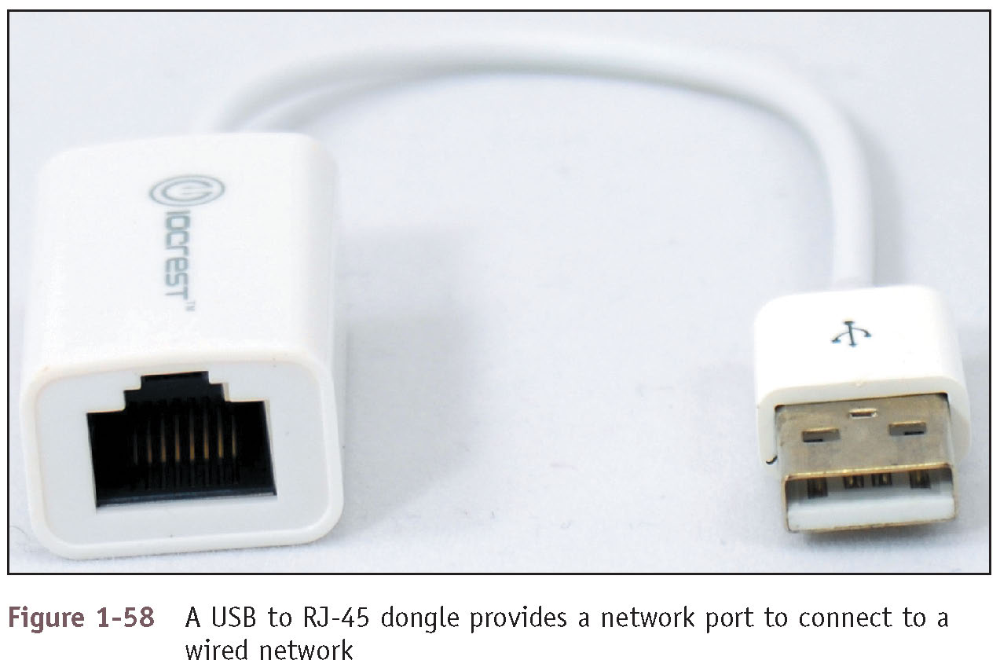
First Look at Laptop Computers (5 of 6)
Figure 1-58 A USB to RJ-45 dongle provides a network port to connect to a wired network

Slide 57
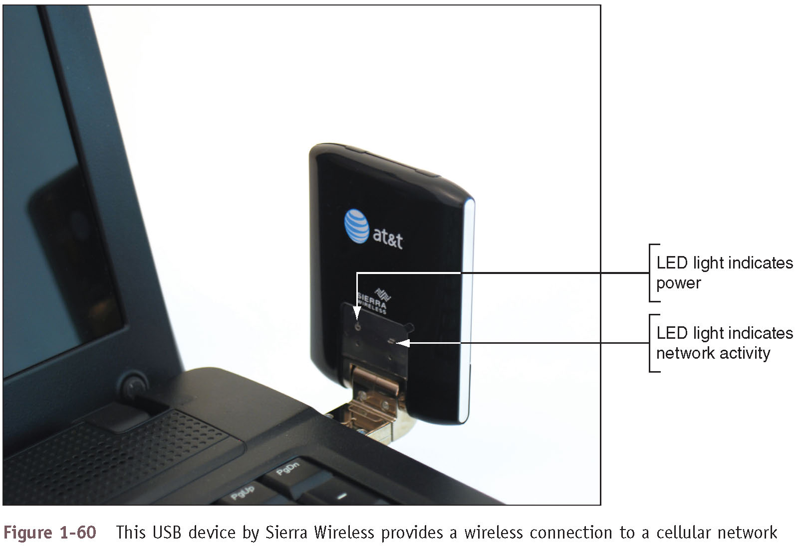
First Look at Laptop Computers (6 of 6)
Figure 1-60 This USB device by Sierra Wireless provides a wireless connection to a cellular network

Slide 58
Special Keys, Buttons, and Input Devices on a Laptop
Button or switches might be above the keyboard
Most of the same settings that these buttons control may also be changed using Windows tools
Some settings might be:
Volume
Keyboard backlight
Touch pad on or off
Screen brightness and screen orientation
Dual displays
Bluetooth, Wi-Fi, or cellular on or off
Media options
GPS on or off

Slide 59
Docking Stations and Port Replicators (1 of 3)
Some laptops have a connector called a docking port
Connects to a docking station
A docking station provides ports to allow a laptop to easily connect to a full-sized monitor, keyboard, AC power adapter, and other peripheral devices
Port replicator (universal docking station) is a device that provides ports to allow a laptop to easily connect to peripheral devices
Not proprietary to a single brand or model of laptop
To use a docking station or port replicator:
Plug all peripherals into docking station or port replicator
Connect laptop to the station
No software needed

Slide 60
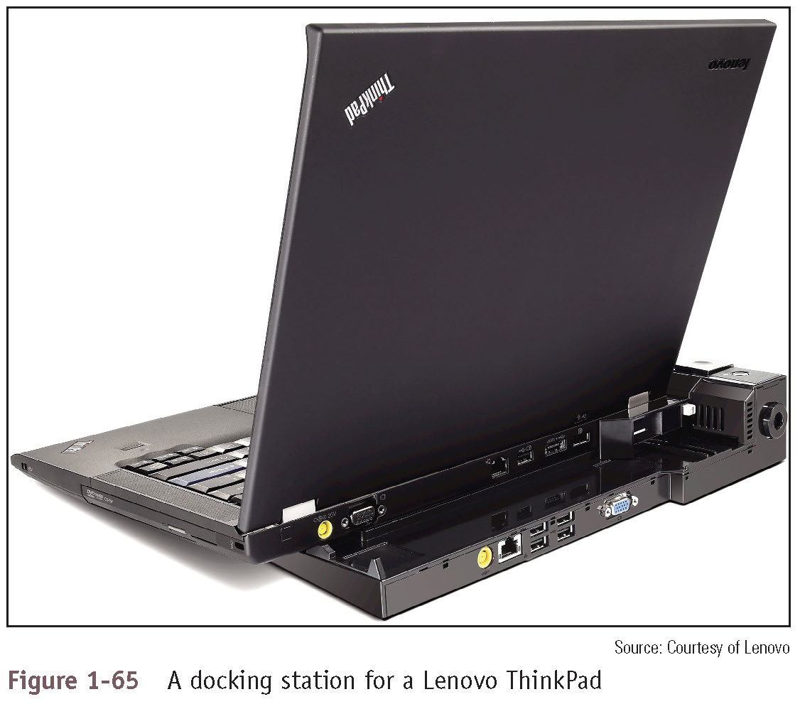
Docking Stations and Port Replicators (2 of 3)
Figure 1-65 A docking station for a Lenovo ThinkPad

Slide 61
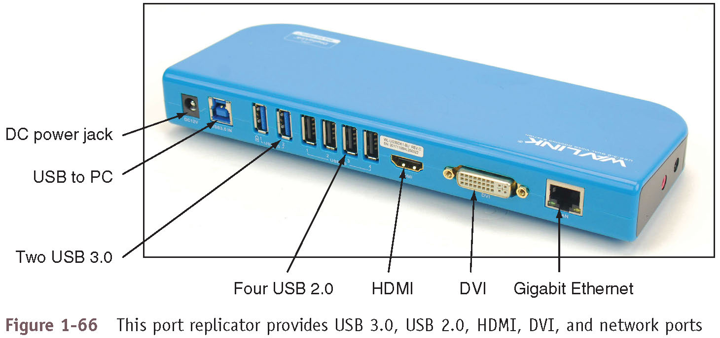
Docking Stations and Port Replicators (3 of 3)
Figure 1-66 This port replicator provides USB 3.0, USB 2.0, HDMI, DVI, and network ports

Slide 62
Special Considerations When Supporting Laptops (1 of 5)
Laptops and their replacement parts cost more than desktop PCs
Factors to consider that apply more to laptop than desktop computers:
Original equipment manufacturer’s warranty
Service manuals and diagnostic software provided by the manufacturer
Customized installation of the OS unique to laptops
Need to order replacement parts directly from the laptop manufacturer or authorized source

Slide 63
Special Considerations When Supporting Laptops (2 of 5)
Warranty Concerns:
Always check to see if laptop is under warranty before servicing
When contacting technical support have the following available:
Laptop model and serial number
Purchaser name, phone number, address
Service options:
On-site
Ship to authorized service center
Phone assistance or online chat

Slide 64
Special Considerations When Supporting Laptops (3 of 5)
Service Manuals and Other Sources of Information:
Service manuals save time
Enables safe laptop disassembly
Some manufacturers only release these to authorized service centers
Locating a laptop service manual
Manufacturer’s website
Support or FAQ pages
Third party websites
User manual
Provides basic maintenance tasks

Slide 65
Special Considerations When Supporting Laptops (4 of 5)
Diagnostic Tools Provided by Manufacturers:
Most laptop manufacturers provide diagnostic software that can help you test components to determine which component needs replacing
Sources:
Manufacturer’s website
CDs bundled with the notebook
Hard drive or floppy disk
Example: PC-Doctor
Included with Lenovo, Fujitsu, and HP notebooks
Can be purchased separately

Slide 66
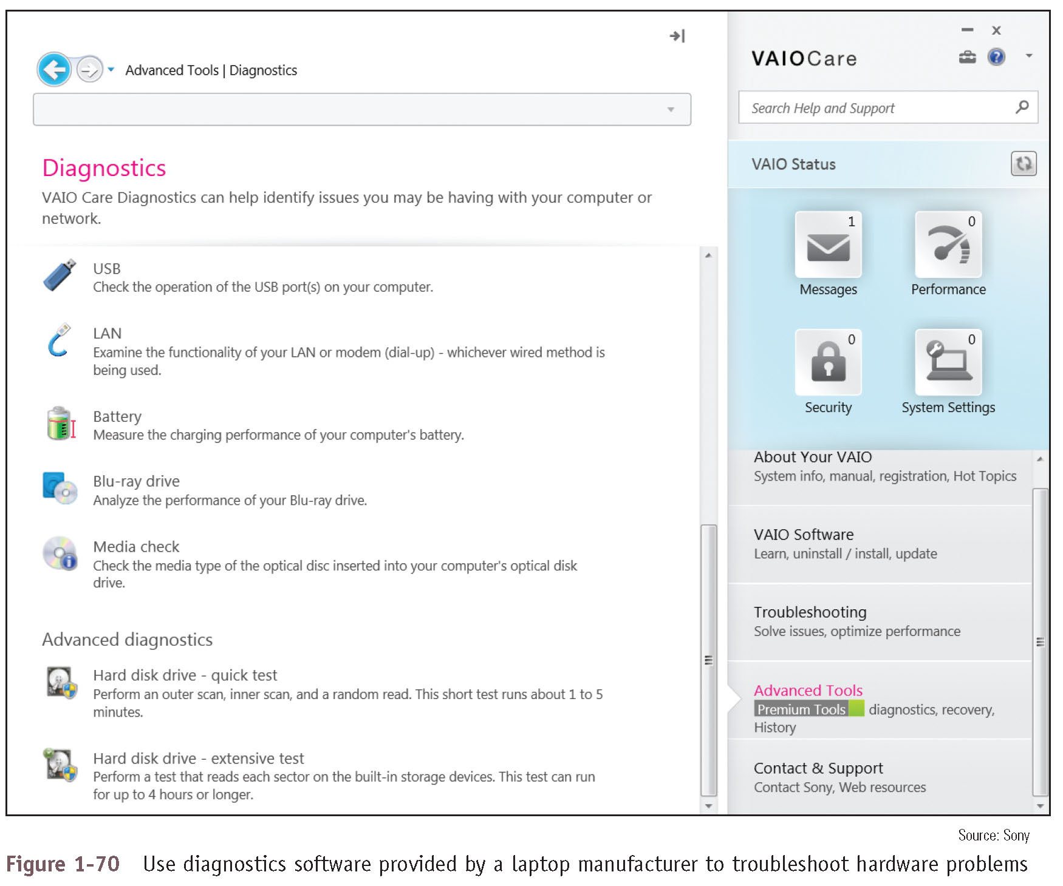
Special Considerations When Supporting Laptops (5 of 5)
Figure 1-70 Use diagnostics software provided by a laptop manufacturer to troubleshoot hardware problems

Slide 67
Working Inside a Laptop Computer (1 of 7)
It may become necessary to open a laptop case to upgrade memory, exchange a hard drive, or replace a failed component
Replacing a failing processor or motherboard can be a complex process
Screws and nuts on a laptop are smaller than a desktop
Require smaller tools
Working on laptops requires extra patience
Always wear an ESD strap

Slide 68
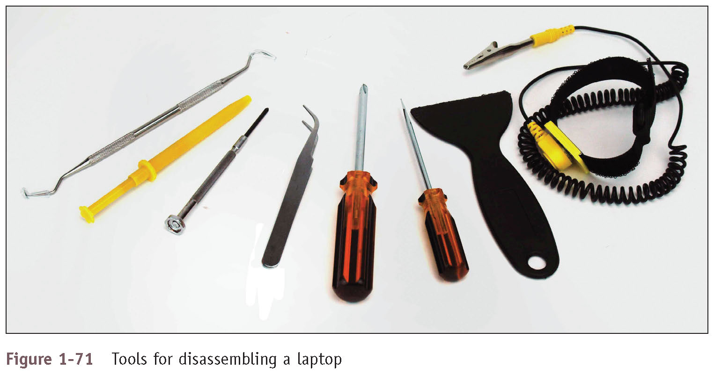
Working Inside a Laptop Computer (2 of 7)
Figure 1-71 Tools for disassembling a laptop

Slide 69
Working Inside a Laptop Computer (3 of 7)
Work methodically:
Some options to keep screws and components organized
Place screws in a pillbox (label each compartment)
Place screws on a soft padded work surface
Use white labeling tape
Place screws on notebook paper
Write where screw belongs
Tape screw beside manufacturer documentation
Keep notes to help with reassembly

Slide 70
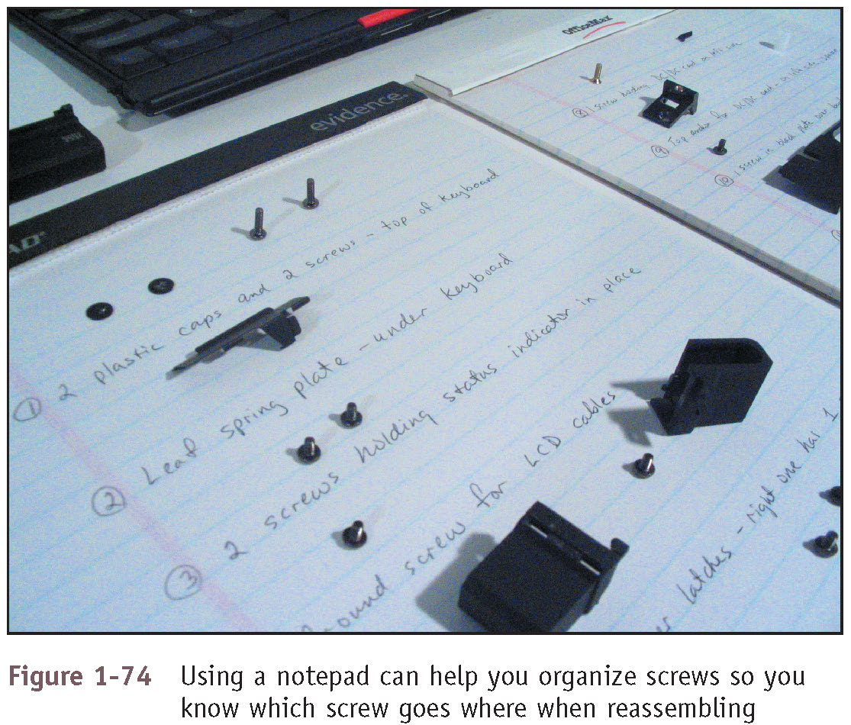
Working Inside a Laptop Computer (4 of 7)
Figure 1-74 Using a notepad can help you organize screws so you know which screw goes where when reassembling

Slide 71
Working Inside a Laptop Computer (5 of 7)
Disassembly tips:
Find the hardware service manual
Consider the warranty might still apply
Opening the case might void the warranty
Take your time and do not force anything
Protect against ESD
Understand ZIF connectors
Pry up plastic covers with dental pick or screwdriver
Plastic screws may be used only once
Disassemble components in order
Use a plastic or metal spudger to slide along the seal and pry open the case

Slide 72
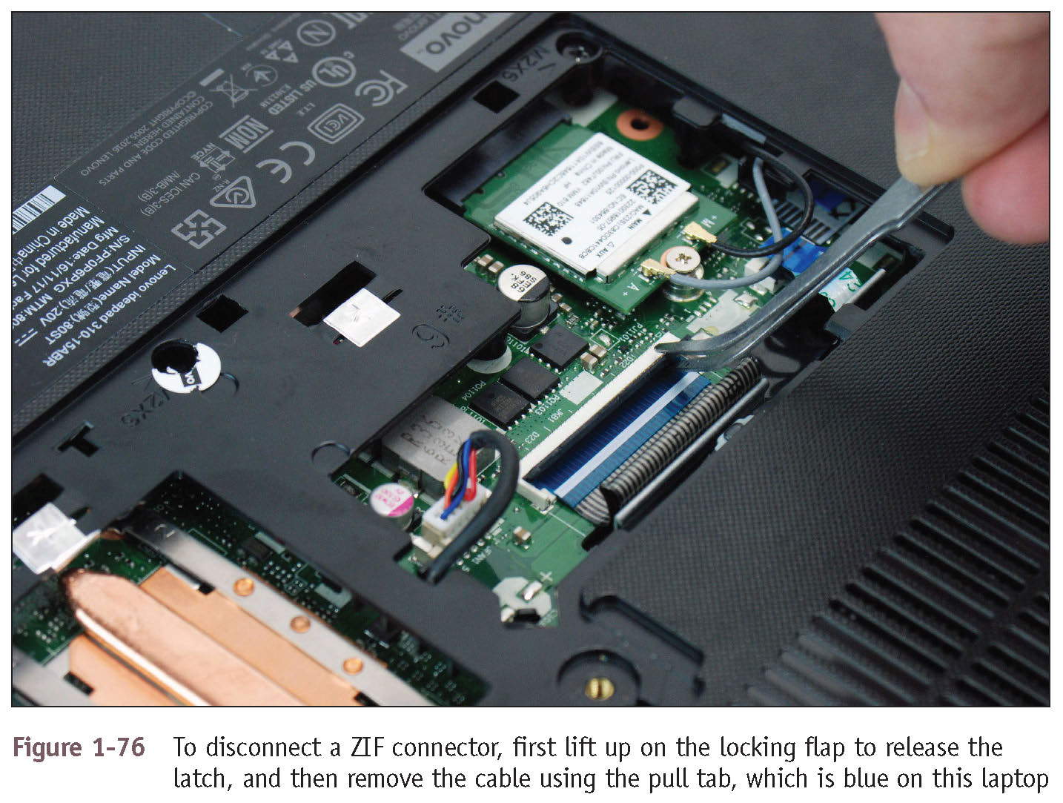
Working Inside a Laptop Computer (6 of 7)
Figure 1-76 To disconnect a ZIF connector, first lift up on the locking flap to release the latch, and then remove the cable using the pull tab, which is blue on this laptop

Slide 73
Working Inside a Laptop Computer (7 of 7)
Reassembly tips:
Reassemble laptop in reverse order
Tighten, but do not over tighten, all screws
Before installing the battery or AC adapter verify there are no loose parts inside the notebook

Slide 74
Exploring Laptop Internal Components
List of important components and the typical order you remove them:
1. Remove or disable the battery pack
2. Remove the hard drive
3. Remove memory
4. Remove the wireless card
5. Remove the optical drive
6. Crack the case
7. Remove the keyboard bezel
8. Remove the system board
9. Remove the CPU, heat sink, and fan

Slide 75
Exploring Inside an All-In-One Computer (1 of 2)
An all-in-one computer uses a mix of components sized for a desktop and a laptop
For some components, you’ll need to buy replacements from the manufacturer because they are most likely proprietary
See the service manual for specific directions about replacing parts

Slide 76
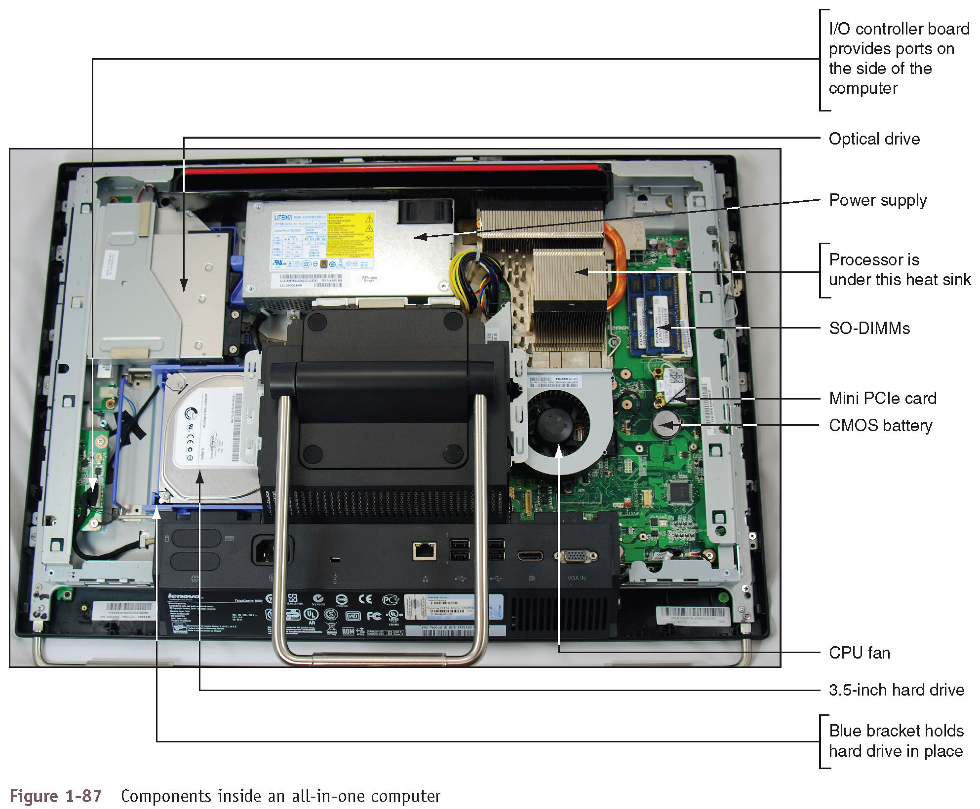
Exploring Inside an All-In-One Computer (2 of 2)
Figure 1-87 Components inside an all-in-one computer

Slide 77
Maintaining Laptops (1 of 3)
General guidelines:
Do not touch LCD panel with sharp objects
Do not pick up or hold by the lid
Use only battery packs recommended by manufacturer
Do not tightly pack in a suitcase – use carrying case
Do not move while hard drive is being accessed
Do not put close to appliances generating strong magnetic field
Always use passwords to protect your laptop when connected to a public network or if device is stolen
Keep laptop at room temperature
Keep away from smoke, water, dust
Do not power up and down unnecessarily

Slide 78
Maintaining Laptops (2 of 3)
General guidelines (continued):
Do not run it while it is in the case, resting on pillow or covered by a blanket
If laptop has been brought inside from the cold, don’t turn it on until it reaches room temperature
Protect laptop against ESD
Remove CD/DVD or USB flash drives before traveling
Take precautions if laptop gets wet
Keep current backups of important data

Slide 79
Maintaining Laptops (3 of 3)
Cleaning tips:
Clean LCD panel with a soft dry cloth
Use compressed air
To clean keyboard, track ball, and touch pad
To blow out air vents
Remove keyboard if keys are sticking and then blow air under keys
Use contact cleaner
Remove battery and clean battery connections

Slide 80
Chapter Summary (1 of 3)
When hardware support technicians disassemble or reassemble a computer, it is important for them to stay organized, keep careful notes, and follow all safety procedures to protect the computer equipment and themselves
Before opening a computer case, shut down the system, unplug it, disconnect all cables, and press the power button to drain residual power
Common tools include an ESD strap, screwdrivers, tweezers, flashlight, compressed air, and cleaning solutions and pads
Internal computer components include the motherboard, processor, expansion cards, DIMM memory modules, hard drive, optical drive, tape drive, and power supply
Cases, power supplies, and motherboards use ATX and microATX form factors
An expansion fits in a slot on the motherboard and is anchored to the case by a single screw or clip

Slide 81
Chapter Summary (2 of 3)
Most hard drives and optical drives today use the serial ATA (SATA) standards for the drive to interface with the motherboard and power supply
Laptop computers are designed for travel
Laptop computer use function keys to control the display, volume, touch pad, media options, GPS, airplane mode, and other features of the laptop
You can use the USB ports for expansion
When an internal component needs replacing, consider the possibility of disabling the component and using an external peripheral device in its place
Replacing the laptop might be more cost effective than performing labor-intensive repairs
When disassembling a laptop, the manufacturer’s service manual is essential

Slide 82
Chapter Summary (3 of 3)
When upgrading components on a laptop, use components that are the same brand as the laptop, or use only components recommended by the laptop’s manufacturer
Special concerns when supporting a laptop also apply to supporting a netbook or all-in-one computer
Internal laptop components you might need to remove when replacing a FRU include the keyboard, hard drive, memory, smart card reader, optical drive, wireless card, screen, DC jack, battery pack, touch pad, speaker, system board, CPU, heat sink, and fan
An all-in-one computer uses a combination of components designed for desktop computers and laptops

